Slide 1


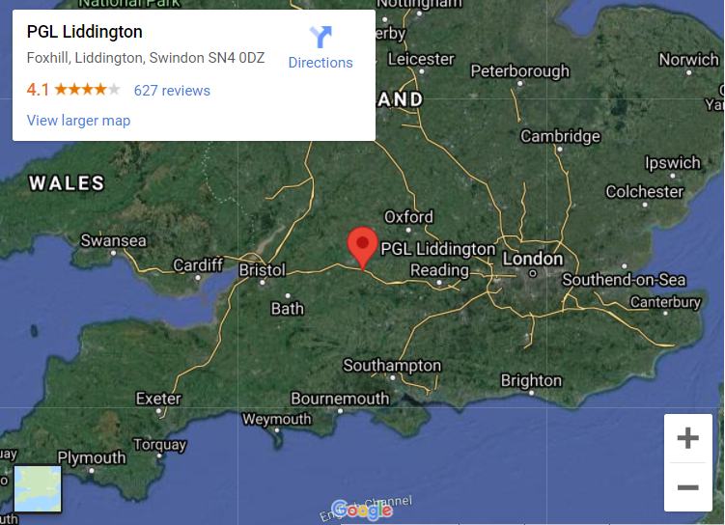
Parents’ Meeting
Year 6 Residential
MONDAY 23rd – Wednesday 25th MARCH 2026
Liddington - PGL Schools & Groups

Slide 2
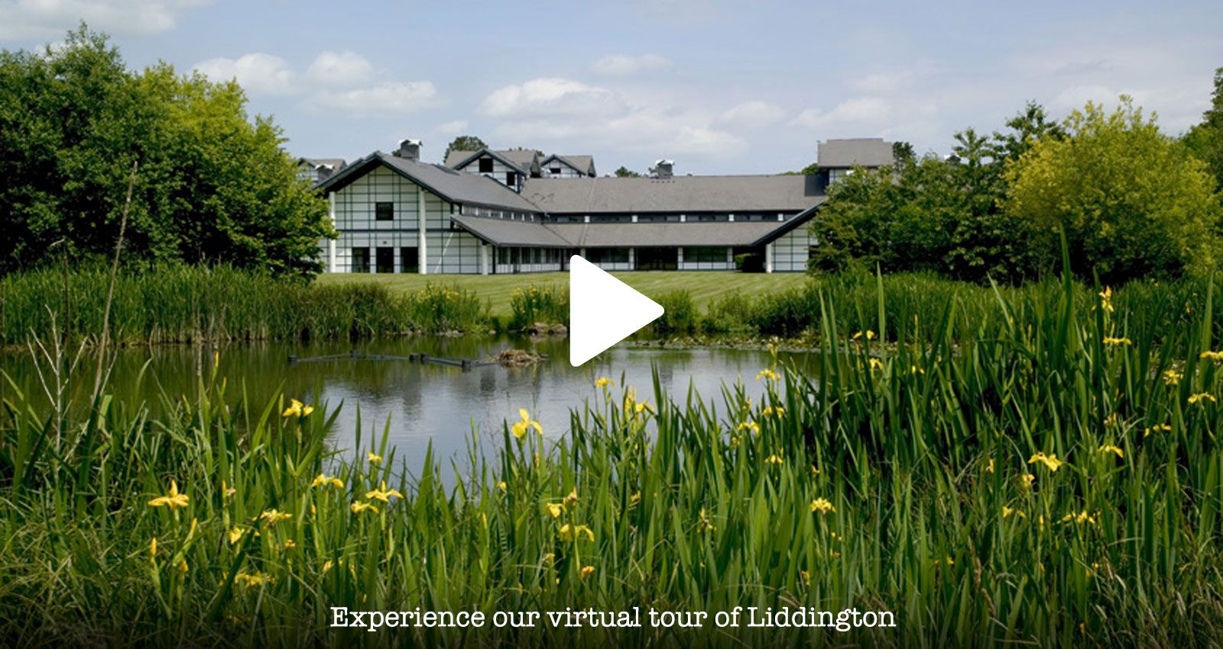
What we offer is different.
At PGL, we believe adventure is crucial in children's lives
It's fun, it's exhilarating. A real hoot with your friends.
It's also a bit different, more challenging, outside your comfort zone. A treasured experience, that's talked about and remembered.
Being away from parents, trying new things, gaining confidence, making new friends, being more self reliant, being encouraged to grow.
Enjoying the freedom of the outdoors.
When it comes to growing up, we think that these things aren't just important - they're essential!
But you already know that. You're a parent.
That's why we believe 'adventure matters'. It's why we're here.
Facilities
The 150 acre site has landscaped lakes for water-based activities, a floodlit all-weather sports pitch and 11 full size football pitches!
With so many activity bases all on-site, you’ll need at least a week here just to get round them all! As well as over 20 different activities, Liddington has several flexible indoor spaces, so whatever the weather you’ll always have something to do!

Slide 3
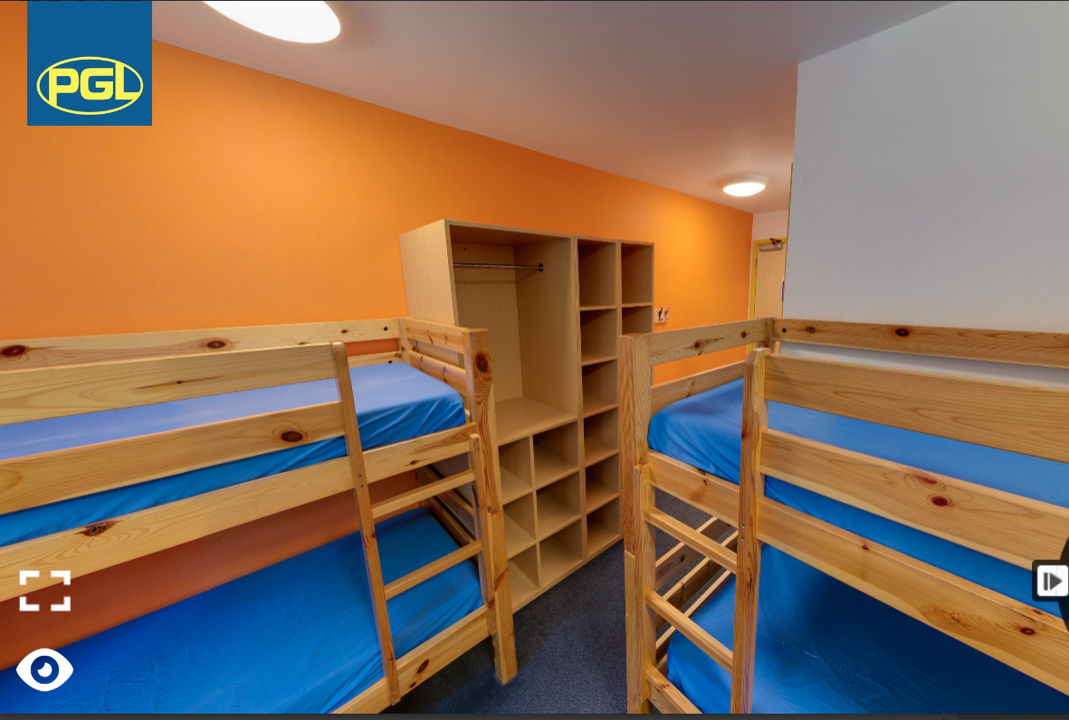
Accommodation
Accommodation
This centre offers fantastic, modern, comfortable accommodation. All the rooms are en-suite and sleep four to six children.
Children will need to bring their own pillows and bedding (sleeping bag or duvet).
These should be in a separate NAMED bag. A bag the children can carry!

Slide 4

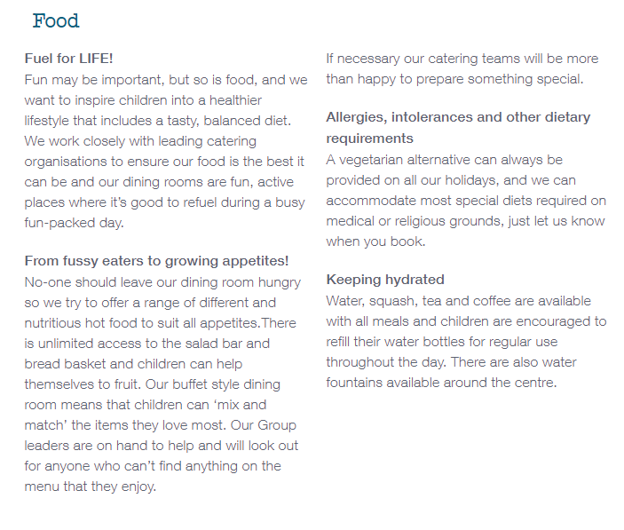
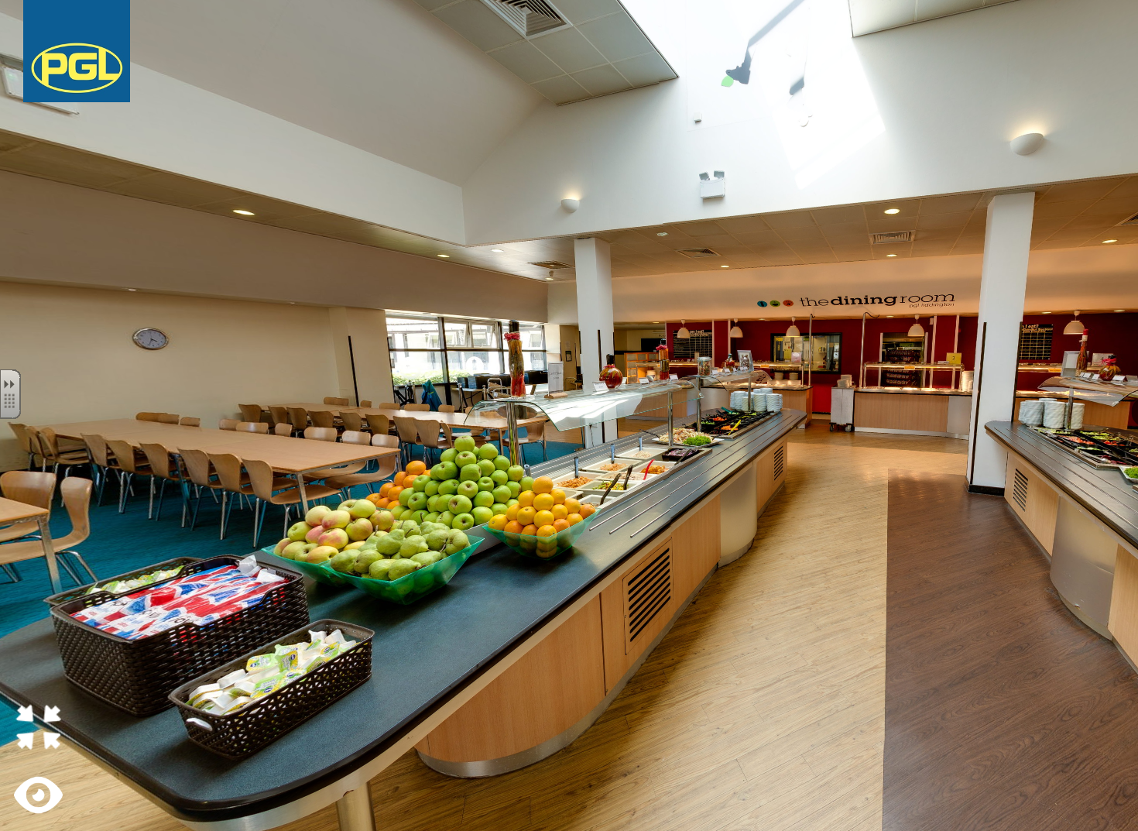
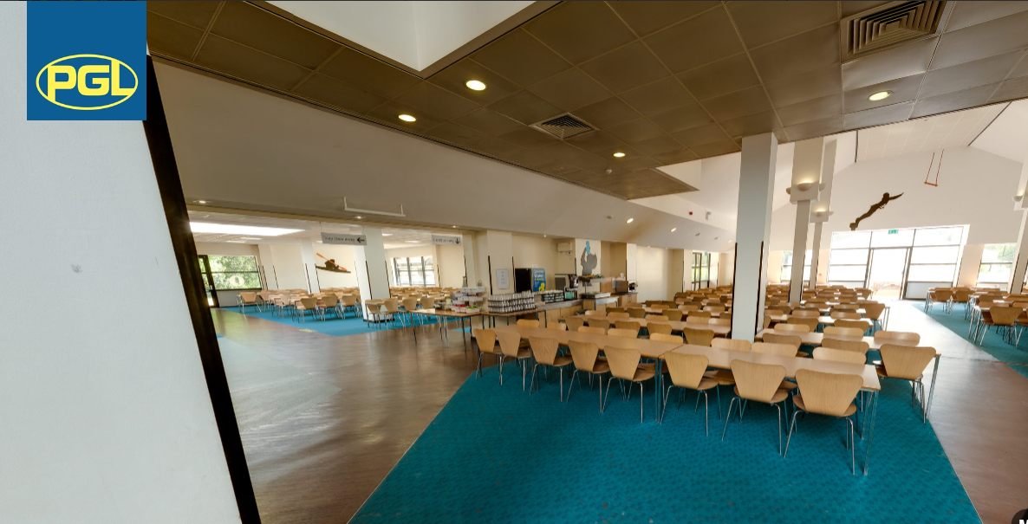
Food

Slide 5
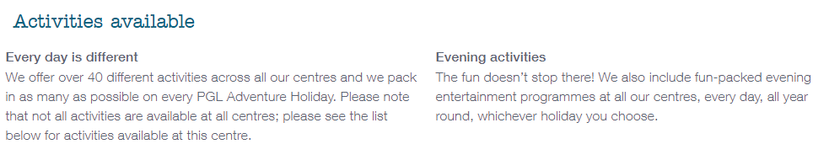
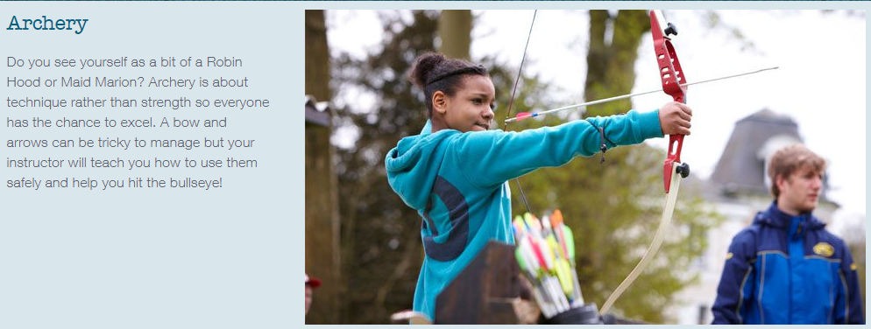
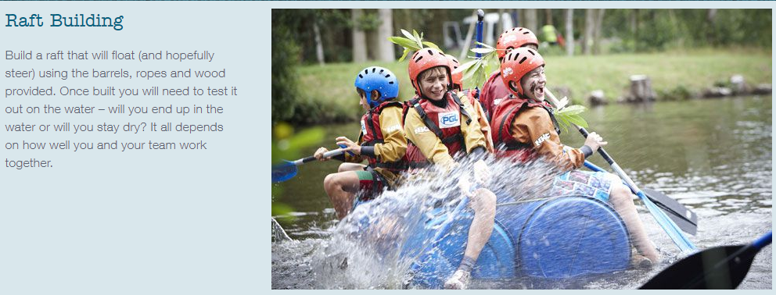
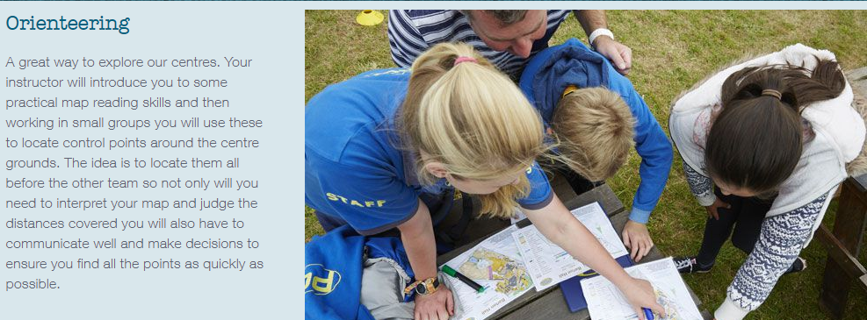
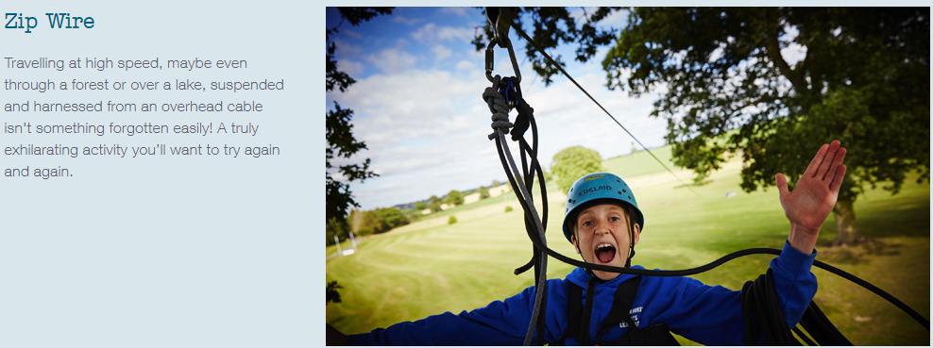
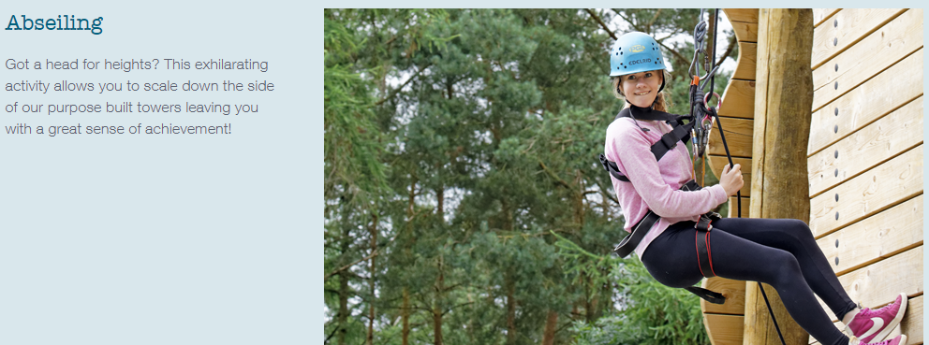
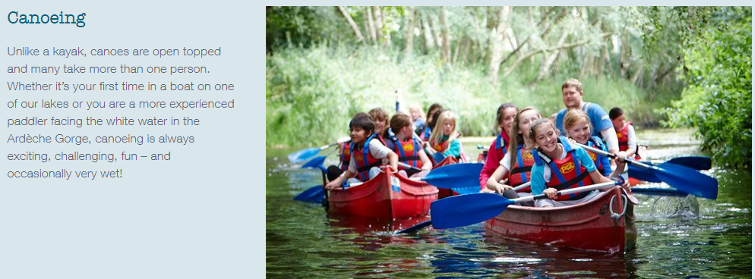
Activities – specific activities tbc

Slide 6
THS Adults:
Mrs B-B
Mrs Drakard
Mr Kwasnik
Miss M
Miss Hunter
Mrs Lyons

Slide 7
Travel:
Arrive at school for 9am on Monday 23rd MARCH .
Coach leaves THS @ 9.30am
Arrive @ Liddington approx. 11.30am
Children MUST HAVE a PACKED LUNCH that we eat on arrival & a WATER BOTTLE they can use again. Afternoon activities begin.
***********
Coach leaves Liddington @ 2:00pm on Wednesday 25th MARCH. Arrival at school approx. 4.00pm.
Arrive @ THS Approximately 3:45pm

Slide 8
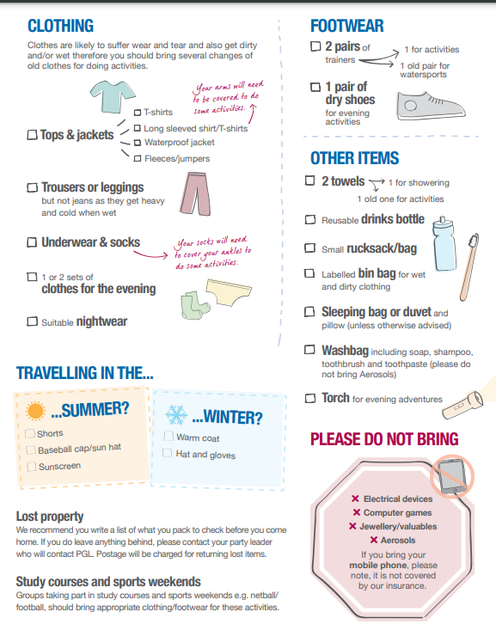
The children MUST have warm clothes AND a waterproof coat!
And 2 pairs of strong trainers/walking boots (no wellies)

Slide 9
Items YOU MUST BRING are:
Clothes
Underwear
Shoes/trainers (no wellies)
Coat /Jacket
Toiletries
Duvet / pillow/ sheet – in a separate bag Towels
Torch – optional – NOT a phone torch….

Slide 10
Items NOT allowed are:
Phones - absolutely not phones! Ipads/tablet etc
Jewellery
Items of value
Aerosol – these will set off the fire alarms! Do bring deodorant! Make sure it’s a roll on

Slide 11
Medication…
Over to Jo!
ALL MEDICAL FORMS must be in as soon as possible. Take home today and return ASAP!
Medication MUST come with your child on the MONDAY.

Slide 12
Groups are sorted and children will be told those on Monday when they arrive at school.
Each group is led by one of the adults.
Groups are for the activities during the days.
Rooms are allocated based upon friendship requests from the children. Every child is with at least one of their preferred friends.

Slide 13
Any questions?

