Slide 1









W
Welcome to Muddy Ducks PRESCHOOL

Slide 2


Slide 3


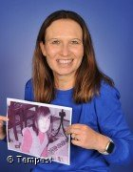

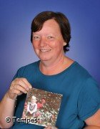
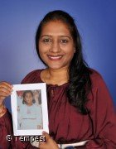
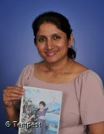

OUR Nursery TEAM
Liane Cameron
Karen saunders
Nursery Room Lead
Keyworker
Mukti parmar
Keyworker
SAJEE GOMES
Keyworker

Slide 4
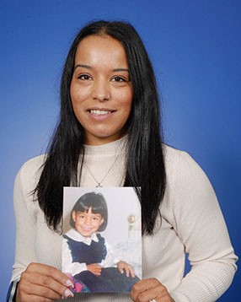
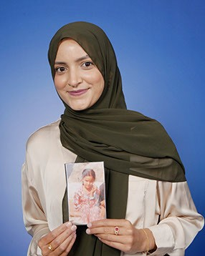
OUR Nursery TEAM
Sam Pinto
Keyworker
Sumaira Khan
Keyworker

Slide 5



OUR SCHOOL
VALUES…
we are THS B.I.R.D.S
B- Brave
I - Inspire
R- Respectful
D- Determined
S- Scholarly

Slide 6

HAND ON HEART
Hand on Heart underpins our approach to managing behaviour at THS.
Therefore, staff work tirelessly to:
  Understand a child’s ‘story’ – what’s happened to them in their little lives so far, not ‘what’s wrong with them’?
  Develop secure attachments with the children in their care
  Ensure that children are kept safe, are seen and soothed and that they feel secure.
  Help children to understand how the 3 main areas of the brain work to support their emotional literacy, co-regulation and, ultimately, work towards self-regulation all of which are far more challenging for a child with ACES.

Slide 7



There are ‘No Outsiders’ at Thomas Hickman School because everyone is included: everyone is welcome and all difference is celebrated.
This is fundamental to our school ethos and permeates all that we do at THS.

Slide 8









Flying Start Curriculum
I am Special
Over the Rainbow
Busy Builders
On the Farm
Minibeasts
On the Beach

Slide 9

THE EARLY YEARS FOUNDATION STAGE (EYFS)
Prime Areas
Personal, Social and Emotional Development
Communication and Language
Physical Development
Specific Areas
Literacy
Mathematics
Understanding the World
Expressive Arts and Design

Slide 10
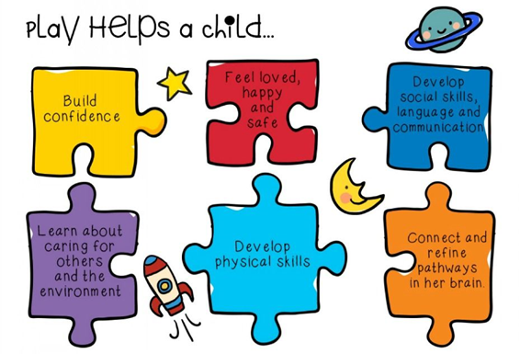
A DAY IN THE LIFE
Morning
Soft Start
Carpet Time
Busy Bird Time
Snack
Singing Time
Lunch at 11:45
Afternoon
Soft Start
Carpet Time
Busy Bird Time
Snack
Singing Time

Slide 11

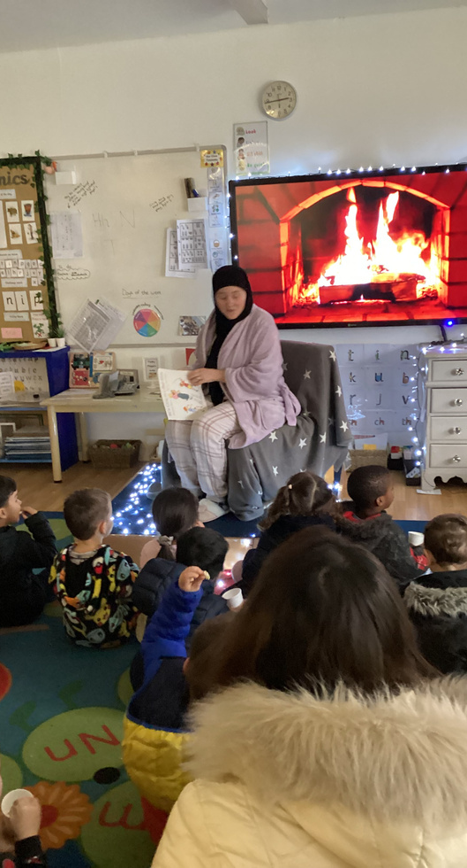
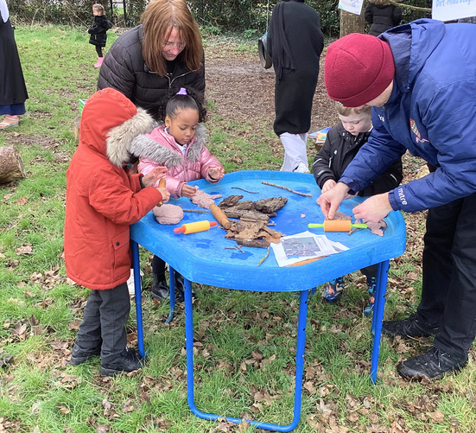
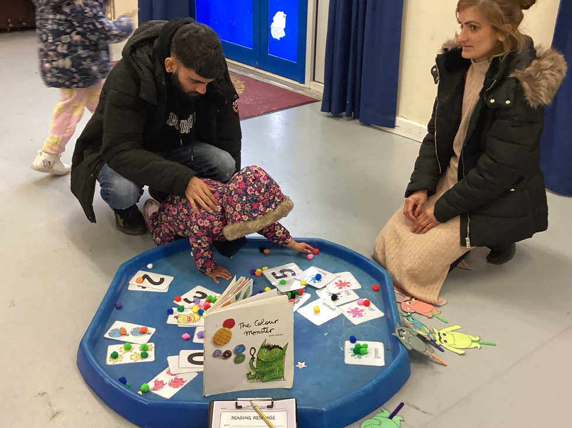
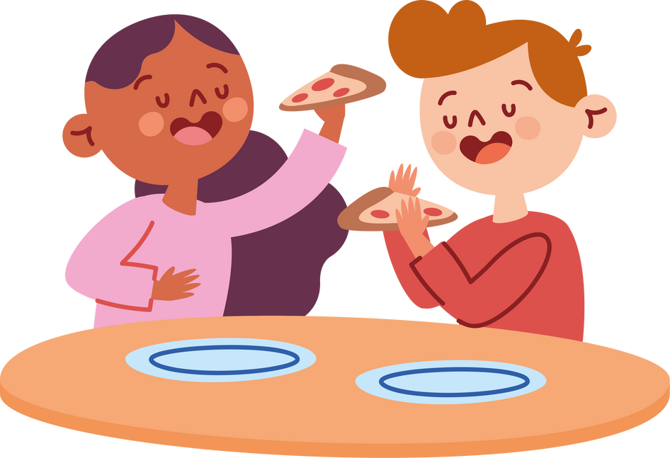
PARENT PITSTOPS
Opportunities for the children to share their learning with you

Slide 12



HELICOPTER STORIES
Early Years Learning and Storytelling Programmes and Resourses. (helicopterstories.co.uk)

Slide 13


FOREST SCHOOL
We have a Forest School Experience once every half term.

Slide 14
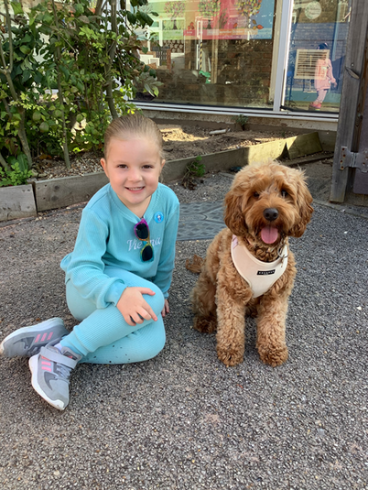

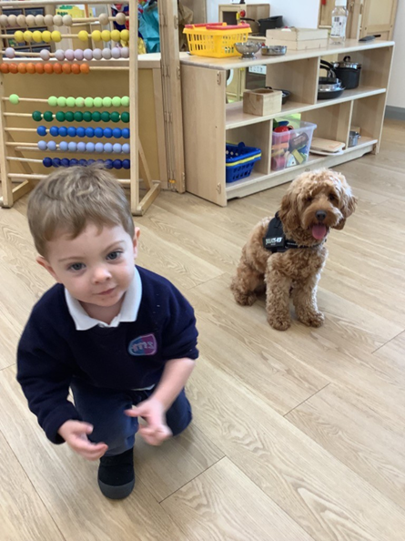
BETSY, OUR SCHOOL DOG
Developing empathy skills in children.
Encouraging respectful behaviour.
Improving relationships between children.
Boosting academic achievement.
Increasing literacy skills.
Calming behaviours.
Enhancing social skills and self-esteem.
Teaching responsibility and respect for all life.
Providing a positive mutual topic for discussion.
Enhancing behaviour and social interaction in the classroom.

Slide 15



WORKING TOGETHER
• Tapestry
  Weekly Memos
  WOW Moments
• Floor Books
• Parent Pit-Stops

Slide 16

DAILY ESSENTIALS
School Uniform
Spare Clothes
Water Bottle
Name Everything!

Slide 17

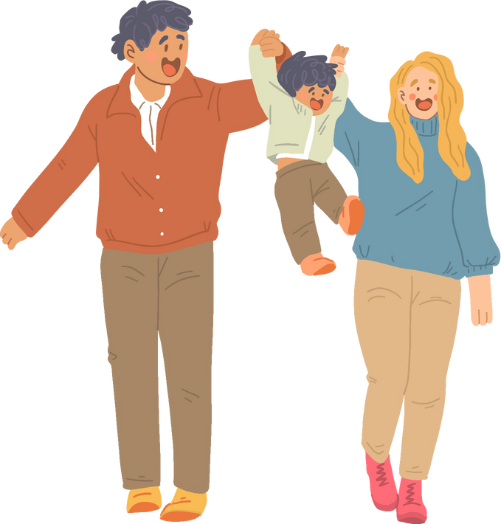
SCHOOL INFO
8:30-8:45 Drop off
3:15-3:30 Pick Up
Attendance
97- up Club: Abizon

Slide 18




QUESTIONS?
01296 485683
eyfs@thomashickman.bucks.sch.uk

