Slide 1









reception
Welcome to Thomas Hickman School

Slide 2


Slide 3


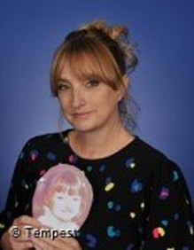
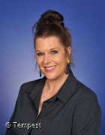

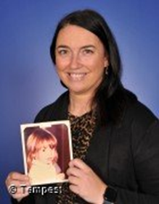

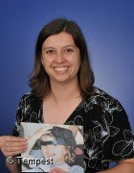

OUR LEADERSHIP TEAM
PIPPA BRAND-BENEE
ABI MANLY
Headteacher
Co-Deputy Headteacher
(Pastoral)
CLAIRE OSBORNE
Co- Deputy Headteacher
(Teaching and Learning)
ABI HUNTER
SENDCo
KIRAN MANN-JONES
Assistant Headteacher

Slide 4
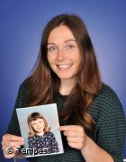
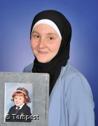

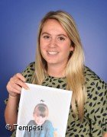

OUR EYFS TEAM
SARAH-JANE O’DONNELL
NORA LAICHE
EYFS Lead
Teaching R Cherry on Thursdays and Fridays.
Reception Lead
Teaching R Cherry from Monday - Wednesday
HOLLY ROBERTS
BETSY
Reception Teacher
Class: R Holly
School Dog

Slide 5
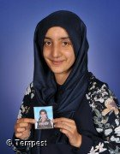
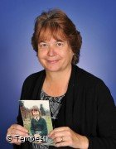

OUR EYFS TEAM
AMRBINE KALSOOM
ELAINE HATCHER
Teaching Assistant
Teaching Assistant
MANCA JUS
Photo to follow
Teaching Assistant

Slide 6



OUR SCHOOL
VALUES…
we are THS B.I.R.D.S
B- Brave
I - Inspire
R- Respectful
D- Determined
S- Scholarly

Slide 7

HAND ON HEART
Hand on Heart underpins our approach to managing behaviour at THS.
Therefore, staff work tirelessly to:
  Understand a child’s ‘story’ – what’s happened to them in their little lives so far, not ‘what’s wrong with them’?
  Develop secure attachments with the children in their care
  Ensure that children are kept safe, are seen and soothed and that they feel secure.
  Help children to understand how the 3 main areas of the brain work to support their emotional literacy, co-regulation and, ultimately, work towards self-regulation all of which are far more challenging for a child with ACES.

Slide 8



There are ‘No Outsiders’ at Thomas Hickman School because everyone is included: everyone is welcome and all difference is celebrated.
This is fundamental to our school ethos and permeates all that we do at THS.

Slide 9
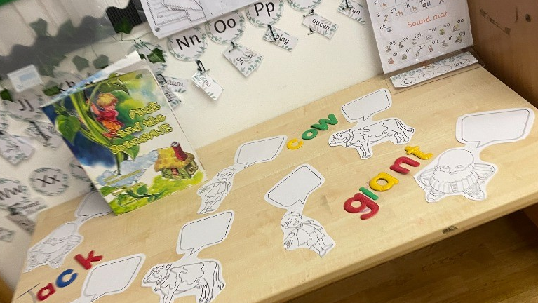
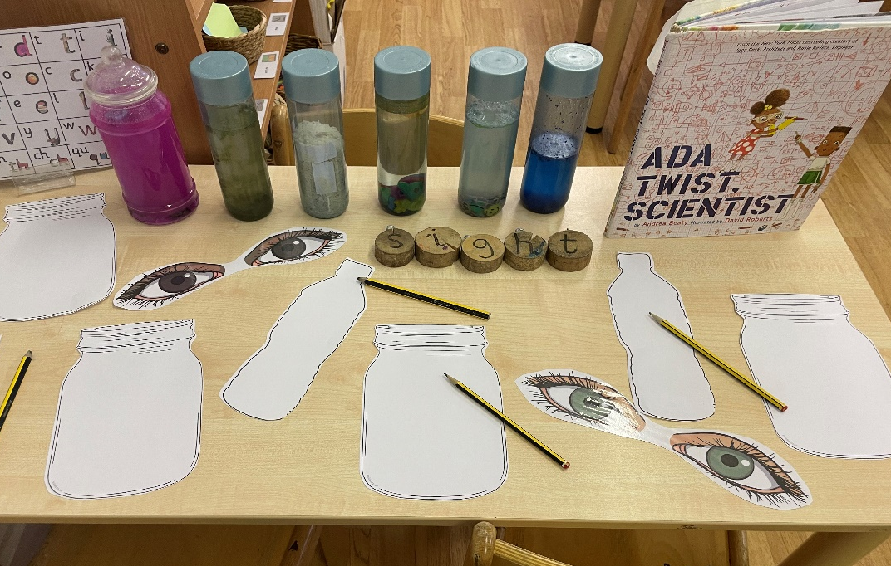

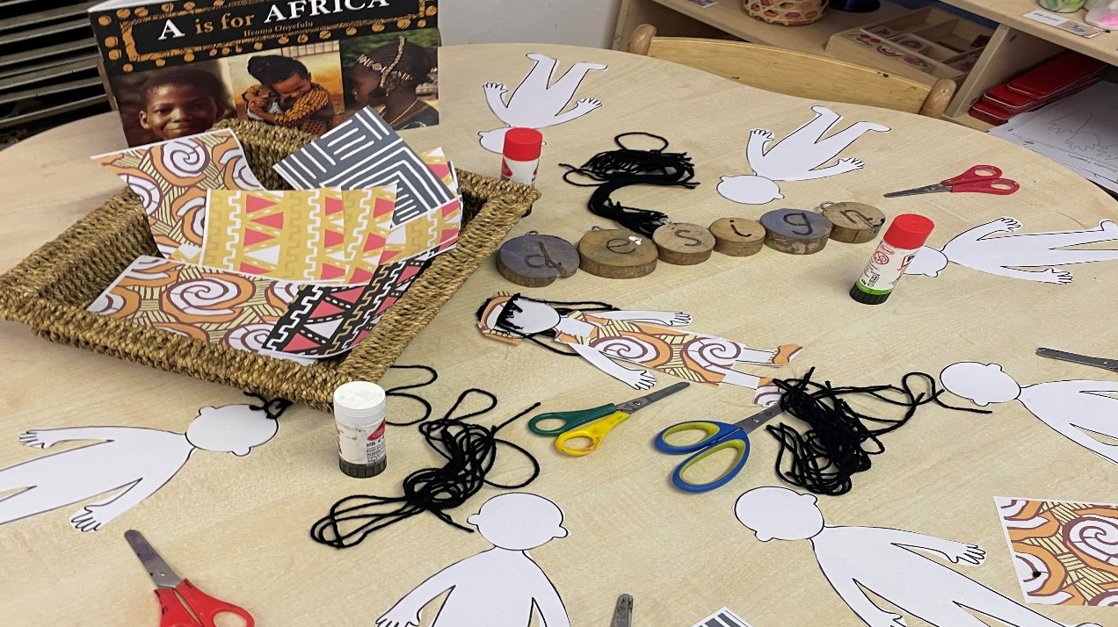
THE EARLY YEARS FOUNDATION STAGE (EYFS)
Prime Areas
Personal, Social and Emotional Development
Communication and Language
Physical Development
Specific Areas
Literacy
Mathematics
Understanding the World
Expressive Arts and Design

Slide 10




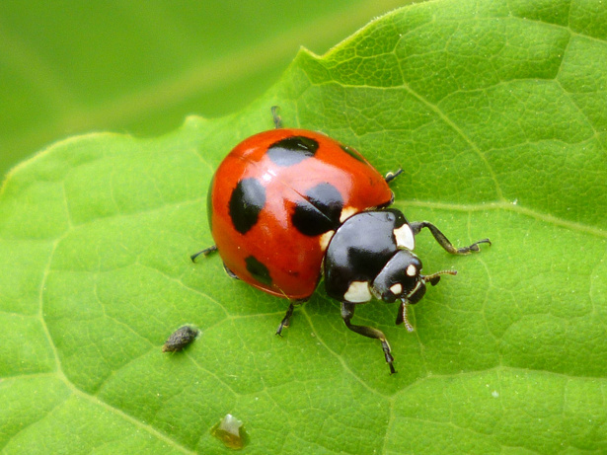



Flying Start Curriculum
Once Upon a
Celebration
Marvellous
Machines
Super Duper Me!
Creep, Crawl, Wriggle
Ready, Steady, Grow
Splash!
Look out on Tapestry for the knowledge orgainiser each term. This will contain key information that you child will be learning!

Slide 11

A DAY IN THE LIFE
Morning
Soft Start
Welcome Registration
Phonics
Snack
Carpet Time Storytime/Field of Study
Busy Bird Time (Continuous Provision)
Lunch at 11:30
Afternoon
Dough Disco
Carpet Time Maths
Busy Bird Time (Continuous Provision)
Helicopter Stories/Poetry Basket

Slide 12


PHONICS
Watch video tutorials on www.ruthmiskin.com
to help you to understand more about Read Write Inc. Phonics and how to help your child read and write at home.
In September you will be invited to 15mins of Phonics for Parents to watch RWI in action!

Slide 13
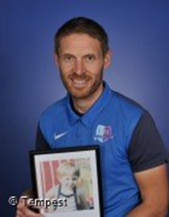
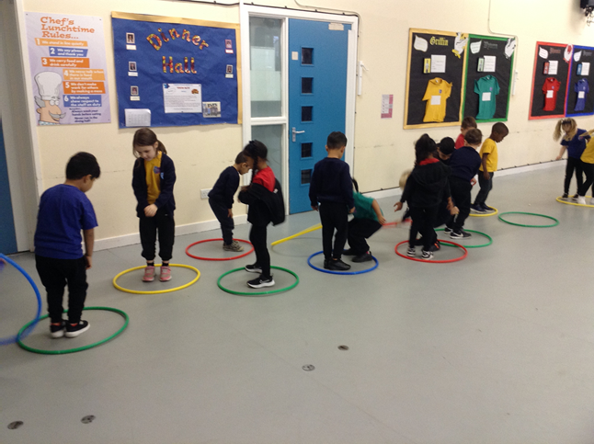



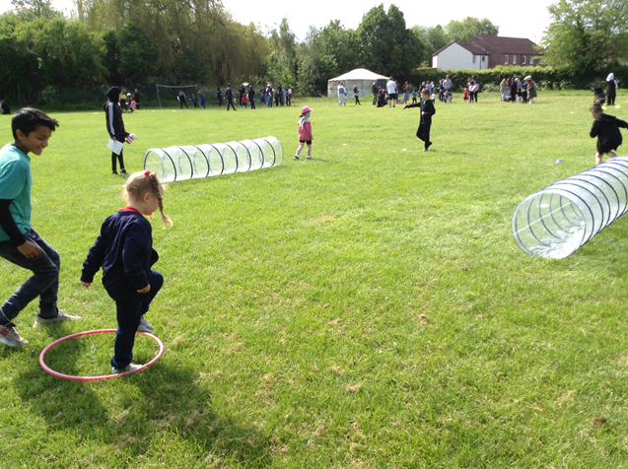
PE

Slide 14



WORKING TOGETHER
• Tapestry
  Weekly Memos
  WOW Moments
• Floor Book –snipets of the best pieces of work from each week
• Parent Pit-Stops
• Reading Eggs
• Homework folders

Slide 15
DAILY ESSENTIALS
School Uniform
Lunches/Lunchboxes
Know Nuts
PE Kit (every Friday)
Water Bottle
Name Everything!

Slide 16


SCHOOL INFO
8:30-8:45 Drop off
3:15-3:30 Pick Up
Attendance
97- up Club: Zoomania

Slide 17





IMPORTANT DATES
Thursday 4th September
First Day 8:30am - 11:30am
Friday 5th September
Second Day 8:30 - 12:30
(with Lunch)

Slide 18




QUESTIONS?
01296 485683
eyfs@thomashickman.bucks.sch.uk

