Slide 1




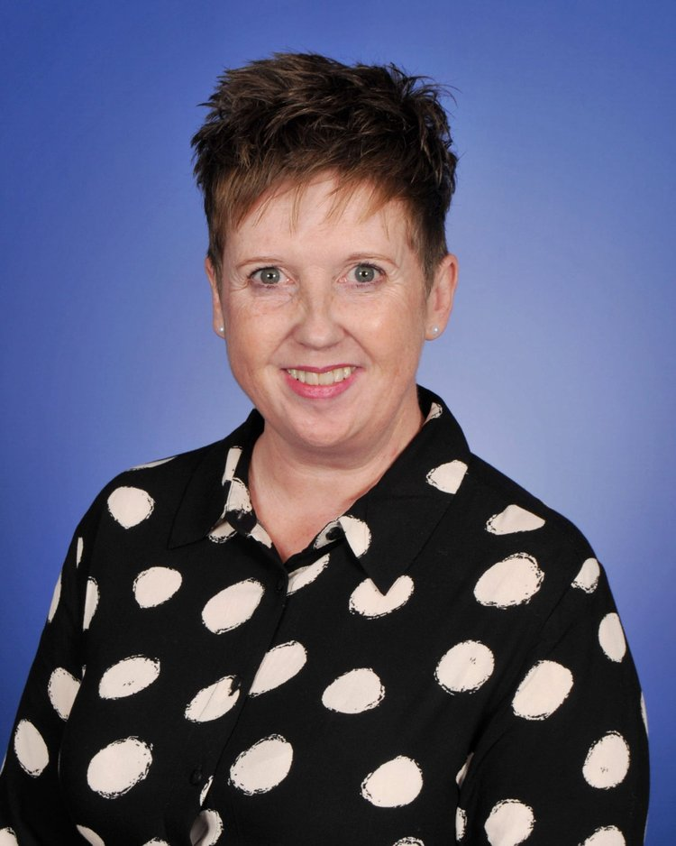



MEET THE TEACHER
2025 -2026
Kim Bourke-Smith
1 Pine

Slide 2

Who am I? Where did I come from? What am I doing here?
  I have worked at THS for 9 years, ranging from Nursery up to Year 5
  I taught in Year 1 last year and I am very excited to be teaching in there again (it’s my favorite year group!)
  I am a school governor
  I am mum to Joseph, Olivia (who works in pre-school) and Reu, my Cavalier King Charles Spaniel

Slide 3


Why your children are important to us?
  Their learning and happiness are important to you so they are important to me. I want the best for them and to be able to provide them with many opportunities.
  Learning is not just about reading, writing and maths but also social and emotional development too.
  In our class there will be a ‘worry monster’ for the children to ‘post’ their worries - if we know about them we can help.

Slide 4


SOaring birds
  We will continue to have ‘Star of the Week’ and postcards home.
  We have a Dojo point system where your children can earn points towards a prize out of the prize box.
  We need your help - encourage your children to do the homework and read as much as possible (we have a phonics screening check in July 2026)
  Ensure they are at school on time, collected promptly and have the correct uniform/kit with them on the right day.

Slide 5
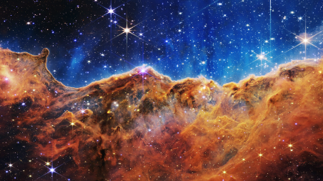

Our first field of study is out of this world
  This FoS teaches the children about the history of space travel compared to todays.
  Your child will also meet our class mascot of the term (he may be a visitor from outer space!)
  We will have a very special visit from Wonder Dome who are going to bring THS their very own portable planetarium and we will also do a study of the local area..

Slide 6

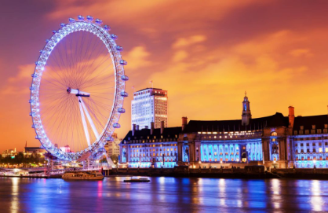
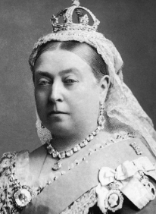
Other Fields of study will be ...
  London is Calling
  Children of the Revolution

Slide 7

Daily routines and expectations
PE Days - The children MUST have their PE kits in school on the first day back.
Homework - Homework will be on Google Classroom and My Maths, children will need to submit their work by the agreed deadline.
Daily Reading at Home - Reading Records continue - please read with your child.
Reading Eggs - a new task will be available each week but your child is more than welcome to complete any activity on Reading Eggs.
Numbots - all children have a log in - please encourage them daily.

Slide 8


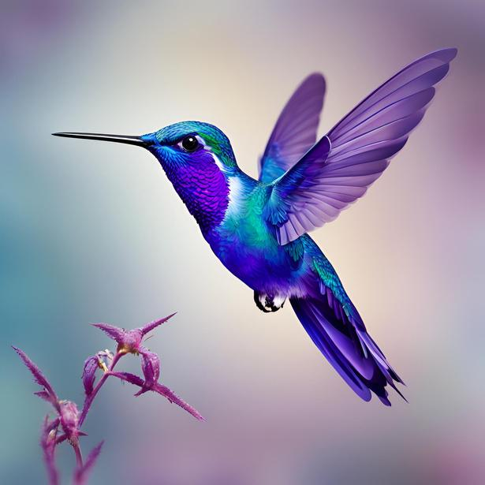
B.I.r.d.s
Behaviour system – Still in place. You know it well ☺

Slide 9

BRAVE
We will be BRAVE and stand up for what is right even when no-one is looking. Everyone has the right to be safe and respected at THS.

Slide 10
Inspirational
Our courage to do the right thing will INSPIRE others around us to follow; we will be strong and lead the way

Slide 11
Respectful
We will be RESPECTFUL to our THS family. We will demonstrate this in class, at playtime and around the school. Our kind hands, kind word and kind heart will show people we all belong together and no BIRD flies alone.

Slide 12
Determined
Even when times are really hard, we stay DETERMINED to follow our school expectations

Slide 13
SCHolars
We ‘grow our brains’ every minute of the day; we are SCHOLARS and understand that sometimes we need to learn how to behave well too - we will accept reminders on how to do this and learn from our mistakes.

Slide 14
we are all B.I.r.d.s
Sometimes we may need to restore our behaviour and reflect on some of the choices we made.
  Off task behaviour
  Inappropriate talking/disrupting others who are trying to learn
  Attention seeking behaviour such as swinging on chair, calling out, impolite words or actions.
  Repetitive noise making, tapping etc. Preventing others from concentrating

Slide 15
R1
Change behaviour choices now.
  Do you need support to restore your behaviour in line with expectations?

Slide 16
R2
BIRDS can’t learn - Time out.
  Work at a reflection station. Complete work at playtime.

Slide 17

R3
BIRDS can’t learn/aren’t safe - Move out
  Move to another classroom with a 15 minute timers. A phone call will be made home to parent/carers to explain that learning is being affected.
  Complete work at playtime and part of lunchtime. Only re-enter the classroom after completely restoring your behaviour.
  Preventing the teacher from teaching.
  Preventing BIRDS from growing their brains.

Slide 18
r4
Urgent changes need to be made
  Working with Assistant Headteacher, Parents/carers will be called into school to meet with AHT and child.
  Playtime and lunchtime is isolated with AHT.
  Unkind word in or outside class
  Unkind action in or out of class
  Behaviour not in-line with BIRDS philosophy.

Slide 19


3 internals only in one term - then external.
R5
Reported behaviour
  Sent to Deputy/Headteacher
  Reported via internal or external exclusion
Deliberately working against school expectations:
  Fighting
  Bullying
  Swearing
  Damaging school property

Slide 20
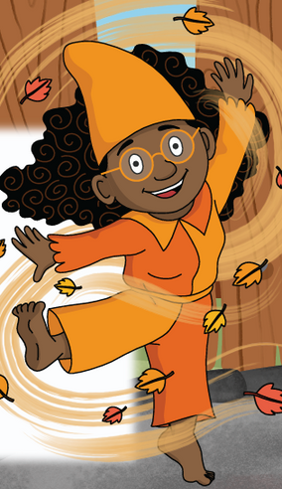
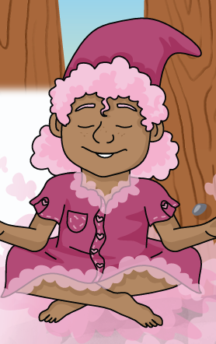
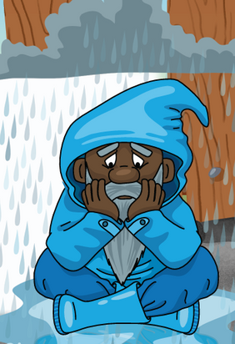
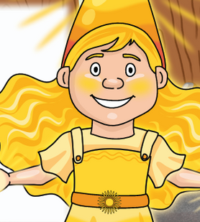




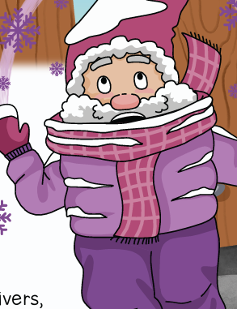
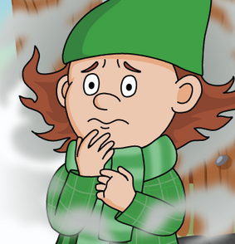
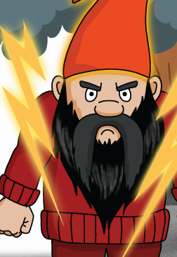
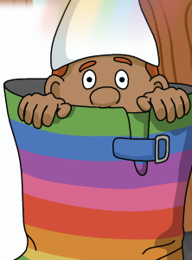




The way we feel can have a huge impact on our day
Excited
SAD
Happy
CALm
Angry
Unsure
Worried
Surprised
Our bodies will react in different ways depending on how we feel

Slide 21
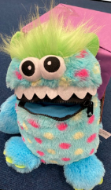
Worry monster
Our Worry Monsters are still here to help you too ... when you are worried about something your body reacts in ways that can leave you feeling terrible ... TELL Worry Monster - they will help!

Slide 22
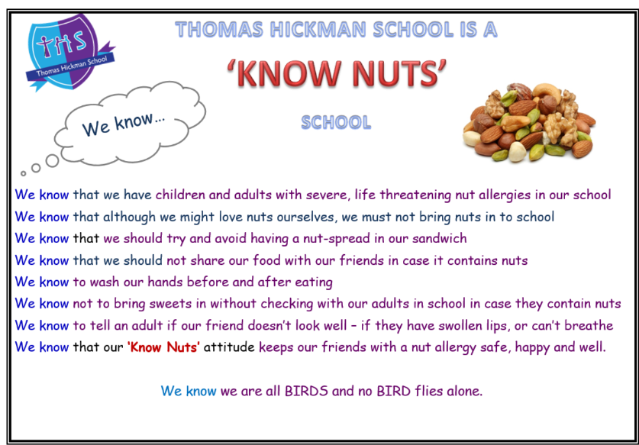

Slide 23
Lets have a Fantastic Year!
See you in September!

