Slide 1

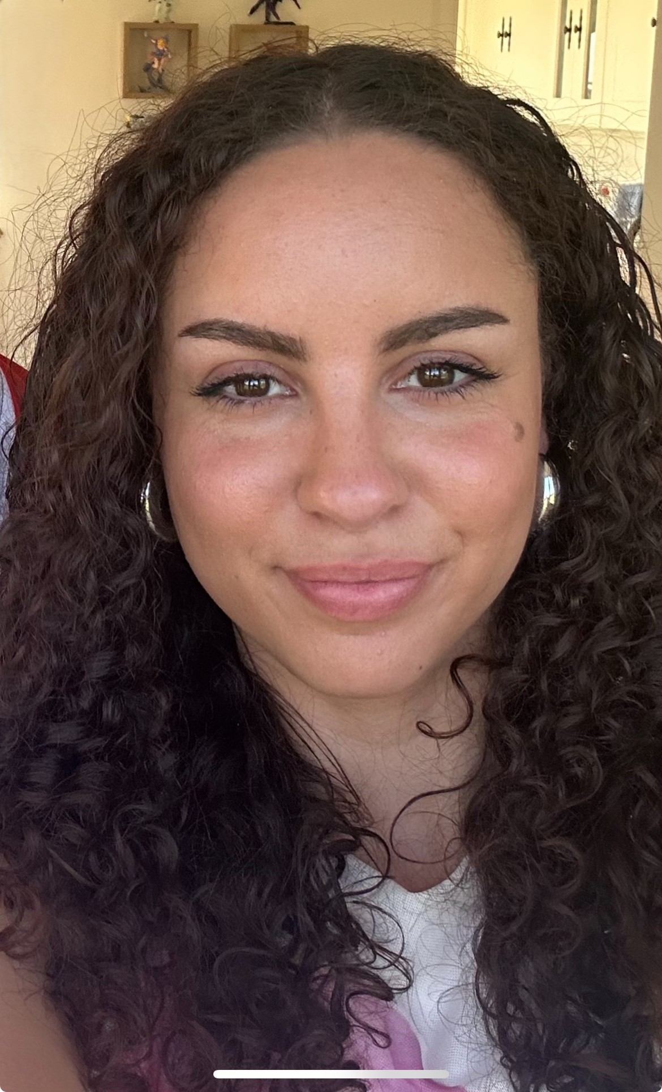
MEET THE TEACHER EVENT – YEAR 2025-26
Megan David
2 Beech
Notes:
I
1

Slide 2
Who am I? Where did I come from? What am I doing here?
I qualified as a primary school teacher in 2024, and I am now an ECT 2 (Early Career Teacher).
I have taught in Year 1, Year 2 and Year 6.
Before going to university I worked at Lynx Gym as a qualified gymnastics coach!
During my time at university, I had worked as a 1:2 TA in Year 1 and also in a nursery.
I live locally with my mum, brother, and my dog, Marni.
I am passionate about learning and encouraging children to reach their full potential.

Slide 3
Why your children are important to us.
Learning is not just about reading, writing and maths – it is about supporting every aspect of growing and developing. The social and emotional development is so important too.
In our classes there will be a ‘worry monster’ for the children to ‘post’ their worries – if we know about them we can help.
Postcards home and our SOAR levels remain – always limitless in our working.
We need your help – Encourage your child to do the homework and read as much as possible, including aloud!
Ensure they are at school on time, collected promptly and have the correct kit with them on the right day.

Slide 4
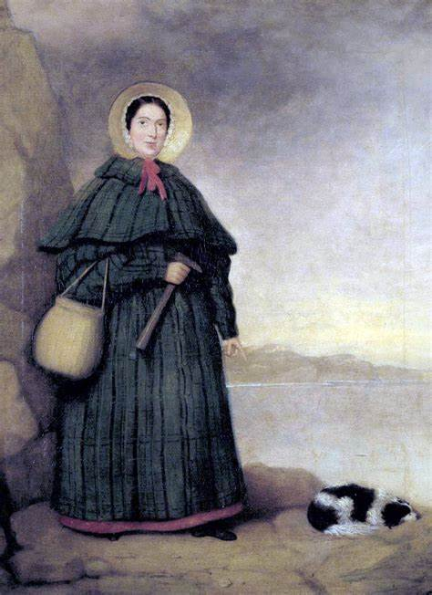
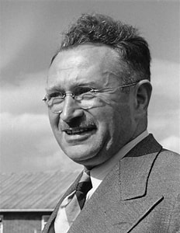
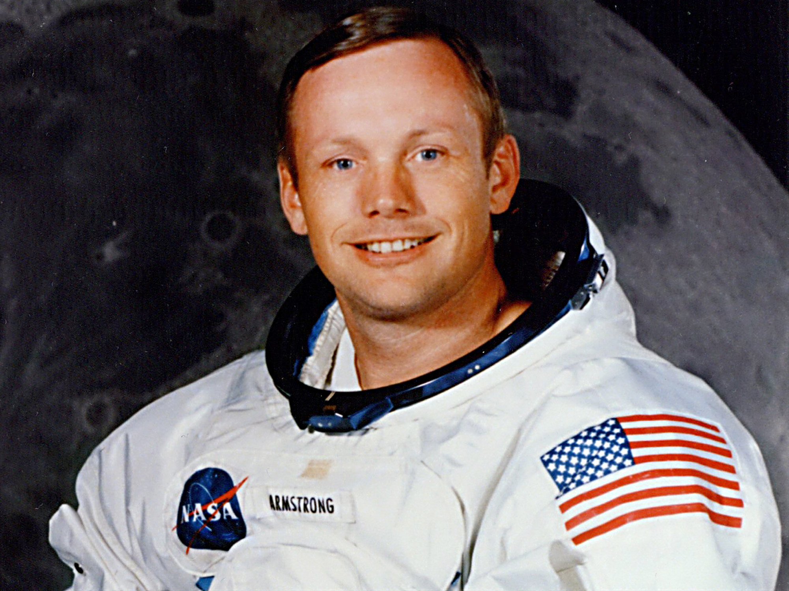
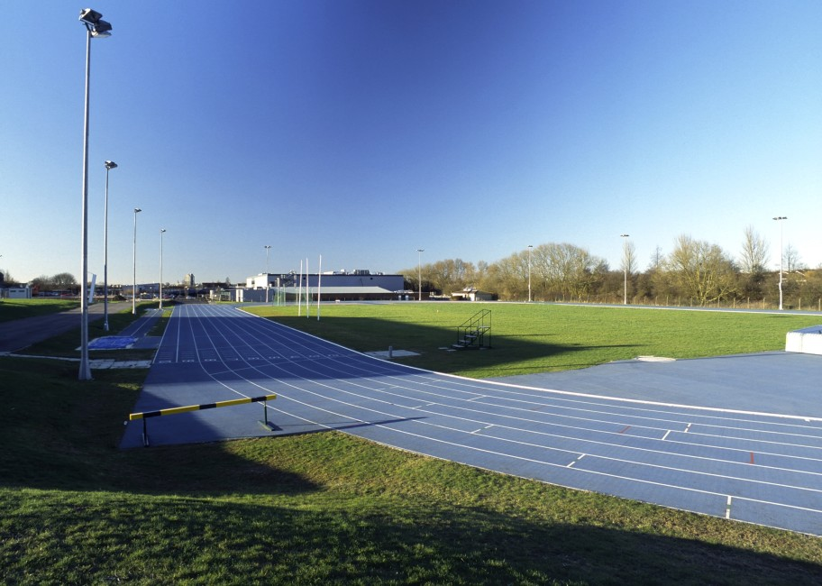
Our first field of study is Unlimited!
This FoS will teach the children about significant individuals in history, including Ludwig Guttmann, Rosa Parks and Neil Armstrong.
We will explore key figures and historical events to discuss the impact of individuals on the world using historical enquiry to evaluate evidence.
We will have a trip to Stoke Mandeville stadium and the National Paralympic Heritage Trust. This links to our FoS and local history, as Ludwig Guttmann established the Stoke Mandeville games for people with disabilities.

Slide 5
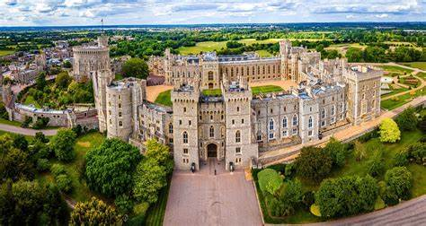
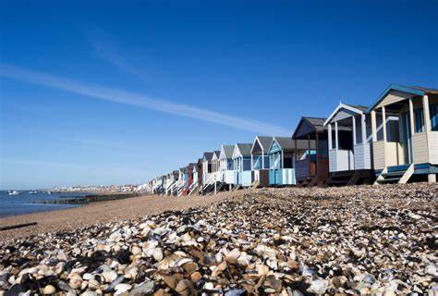
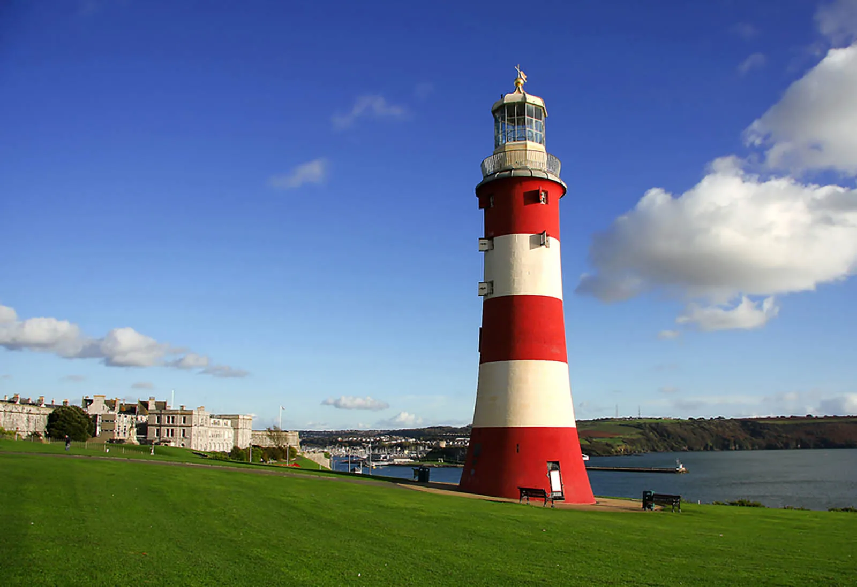
Other Fields of Study will be…
Long live the King!
Crabs, coasts and cornettos.

Slide 6
Daily Routines and Expectations
PE days – The children MUST have their PE kit in school on the first day back.
Homework – Homework will be on Google Classroom, children need to submit their work by the agreed deadline.
Daily Learning kit – We will provide them a pack/pencil case – it is to be looked after!
Daily Reading at home – Reading Records continue – please read with your child. They must be brought in every day.
Contact us at office@thomashickman.bucks.sch.uk

Slide 7
B.I.R.D.S.
Behaviour system – Still in place. You know it well ☺
However, we are always looking to make THS even better and there will be some subtle changes to this next year. You and your children may not notice them day-to-day, but they will focus on developing further our holistic approach to supporting children and families in a bid to make THS and even happier and healthier place to be so that we can maximise learning and success.
Notes:
7

Slide 8
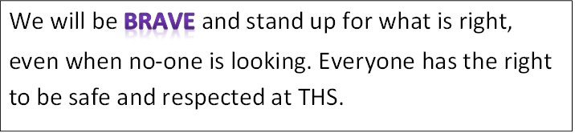
BRAVE

Slide 9
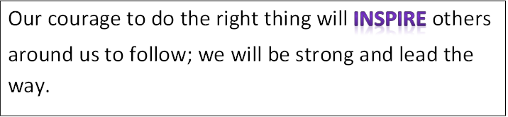
INSPIRE

Slide 10
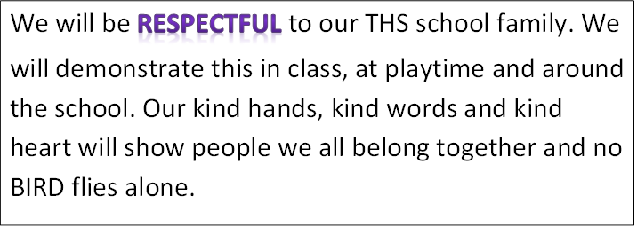
RESPECTFUL

Slide 11
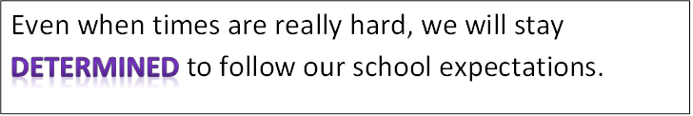
DETERMINED

Slide 12
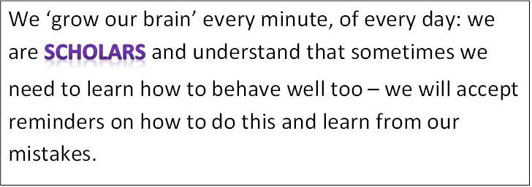
SCHOLARS

Slide 13
B.I.R.D.S
We are all…
Sometimes we may need to restore our behaviour and reflect on some of the choices we made.
Off task behaviour Inappropriate talking/disrupting others who are trying to learn
Attention seeking behaviour such as swinging on chair, calling out, impolite words or actions.
Repetitive noise making, tapping etc.
Preventing others from concentrating

Slide 14
R1
Change behaviour choices now.
Do you need support to restore your behaviour in line with expectations?

Slide 15
R2
BIRDS can’t learn – Time out.
Work at reflection station. Complete work at playtime.

Slide 16
R3
BIRDS can’t learn/aren’t safe – Move out.
Move to another classroom with a 15 minute timer. A phone call will be made home to parent/carers to explain that learning is being affected.
Complete work at playtime and part of lunchtime Only re-enter the classroom after completing restoring your behaviour.
Preventing the teacher from teaching
Preventing BIRDS from ‘growing their brains’.

Slide 17
R4
Urgent changes need to be made.
Working with Assistant Headteacher. Parents/carers will be called into school to meet with AHT and child.
Playtime and lunchtime is isolated with AHT.
Unkind words in or outside class. Unkind action in or out of class. Behaviour not in-line with BIRDS philosophy.

Slide 18
R5
Reported behaviour
Sent to Deputy/Headteacher.
Reported via internal or external exclusion.
Deliberately working against school expectations:
fighting
bullying
swearing
damaging school property
A maximum of 3 internal exclusions in a term can be made before external exclusion is required.

Slide 19
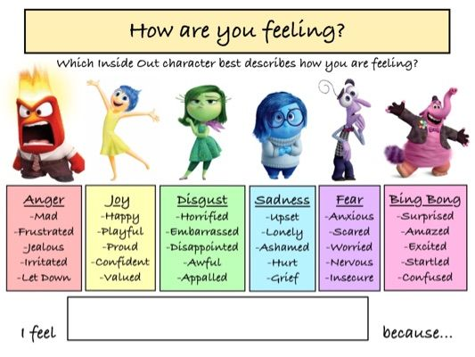
The way we feel can have a huge impact on our day.
Our body will react in different ways depending on how we feel.

Slide 20
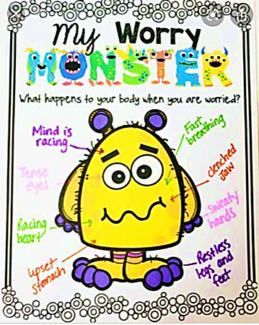
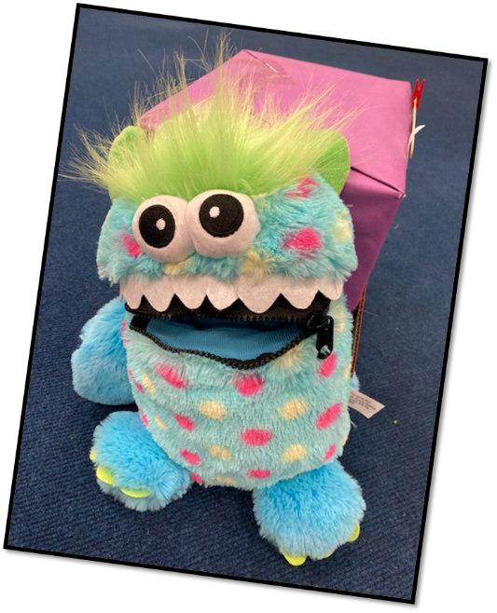
Our Worry Monsters are still here to help you too… when you are worried about something your body reacts in ways that can leave you feeling terrible…
TELL Worry Monster they will help!

Slide 21
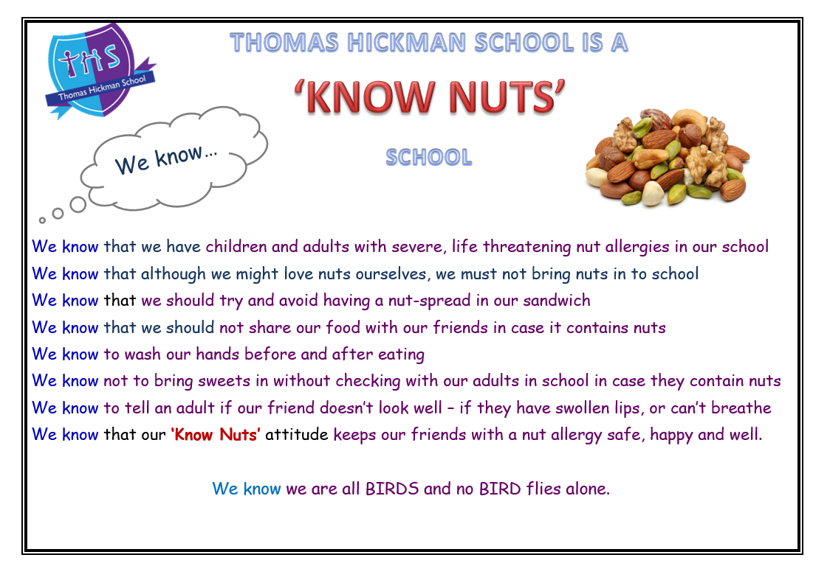

Slide 22
I look forward to seeing you in September and continuing our journey to success!

