Slide 1

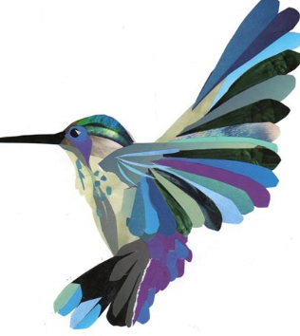
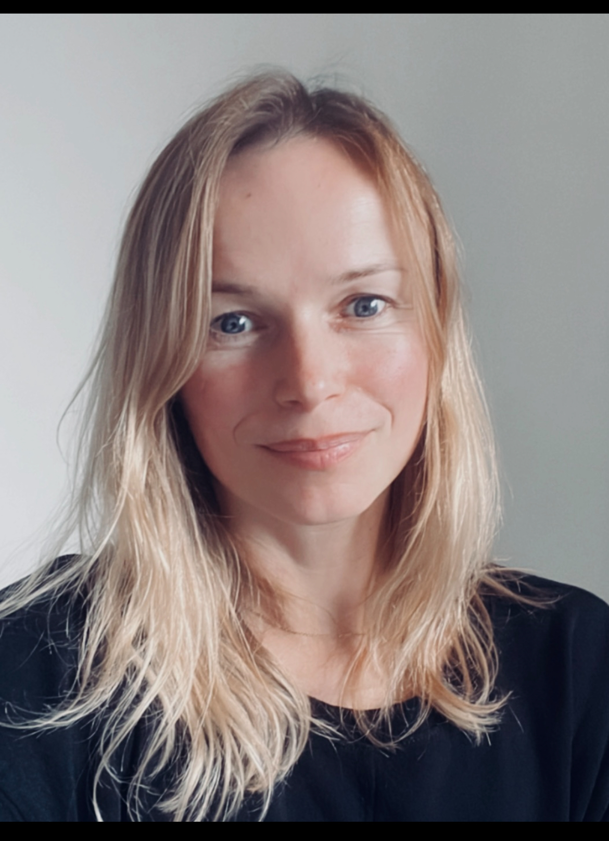

Meet the teacher Year 2
2 Lime – Anna Rymczuk
Notes:
I am happy for you to add any pictures etc. which relate to your Move-up Day’s field of study.

Slide 2

Welcome to Class 2 Lime!
Hello, my name is Anna Rymczuk. I am joining Thomas Hickman as an ECT with lots of experience working across Key Stage 1 and Key Stage 2.
I have taught in Year 1, Year 2, Year 3 and Year 4.

Slide 3
Who am I? Where did I come from? What am I doing here?
I am originally from Poland but moved to England 20 years ago.
I have always wanted to be a primary school teacher, following in the footsteps of my mum, dad and sister.
I have 2 sons and a very cheeky cat called Lexi.
I am passionate about learning and love helping children believe in themselves, take on challenges and realise they are capable of amazing things.

Slide 4
Why your children are important to me…
Because they all bring something unique and valuable to our classroom! They have the potential to achieve their best.
In our classes we have a helpful worry monster who can always be depended upon for any issue – no matter how big or small!
Postcards home and our SOAR levels remain – always limitless in our working.
We need your help – Encourage your child to do the homework and read as much as possible, including aloud!
Ensure they are at school on time, collected promptly and have the correct kit with them on the right day.

Slide 5
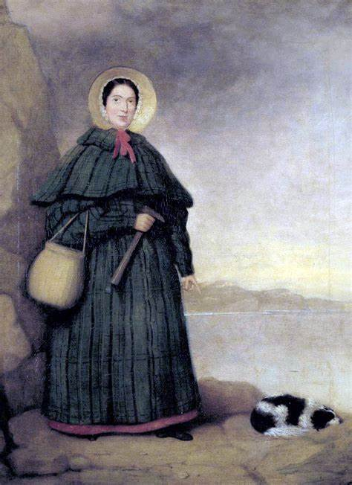
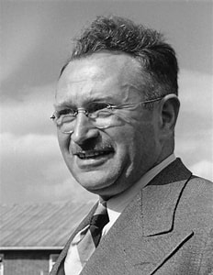
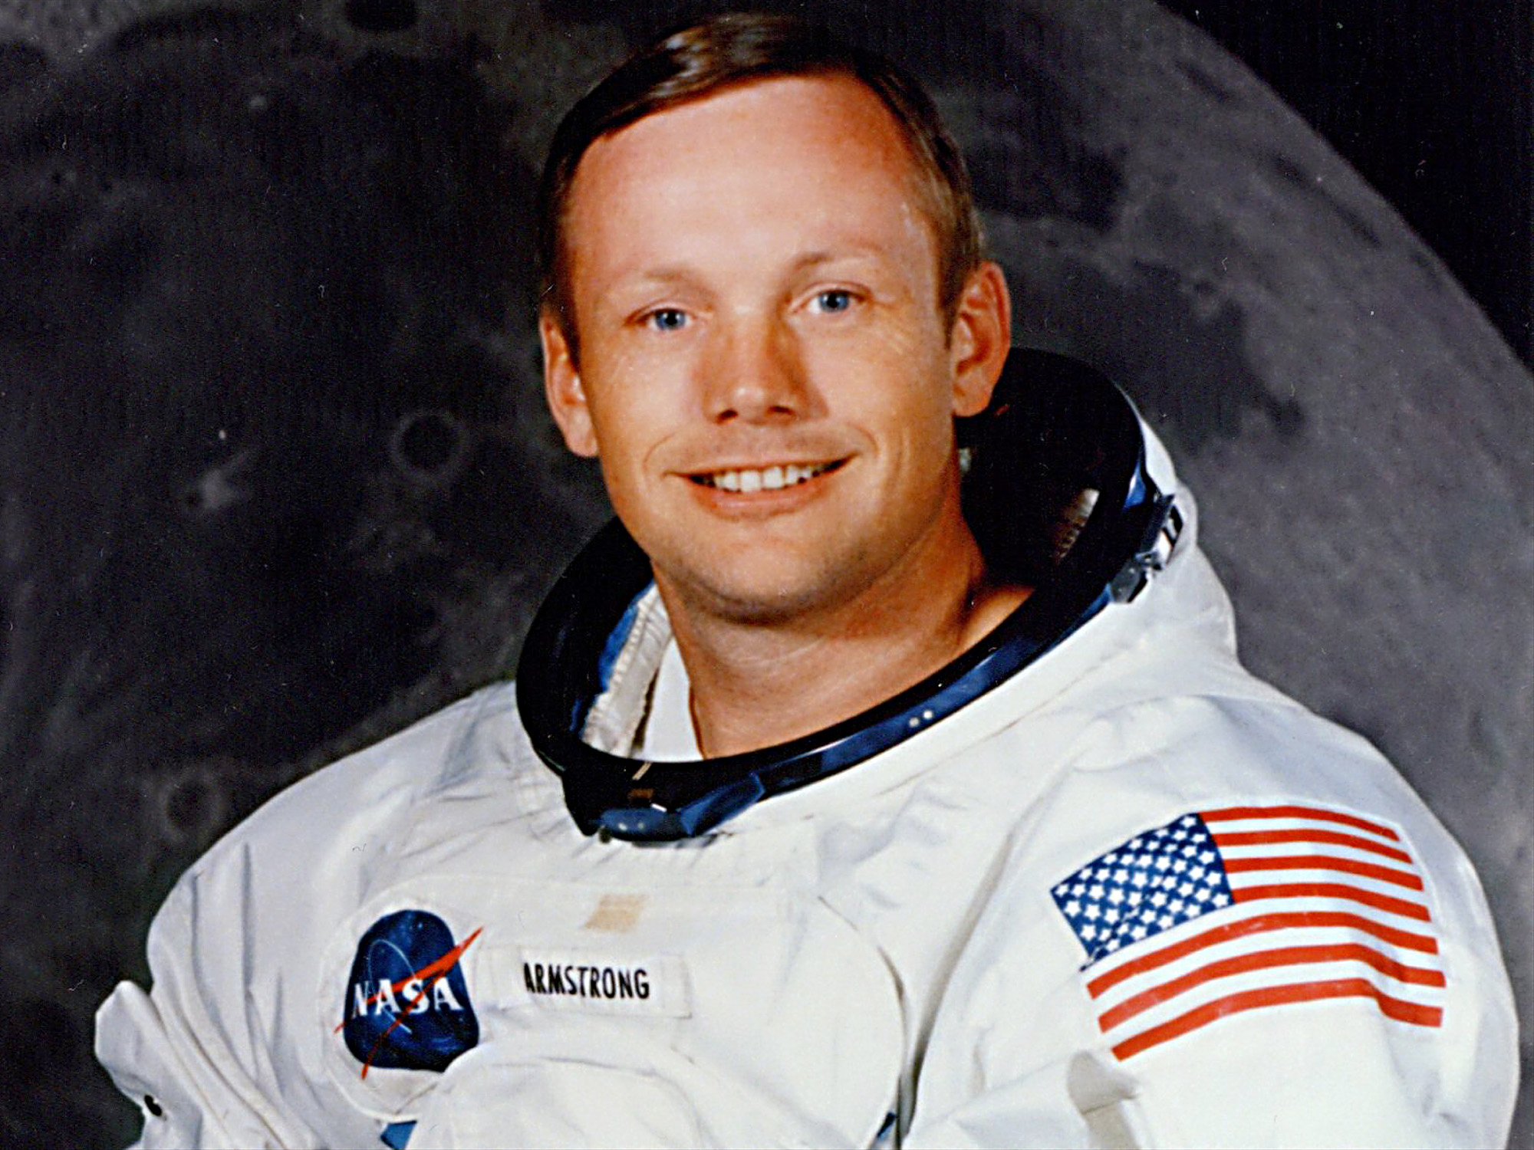
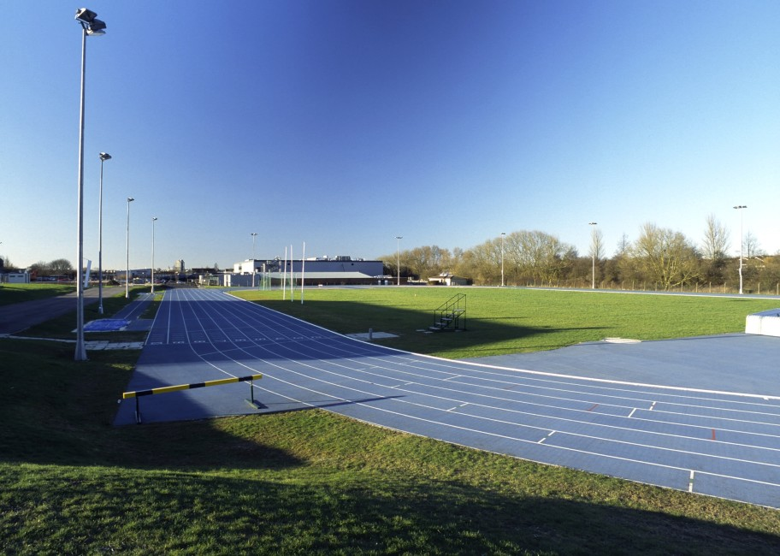
Our first field of study is Unlimited!
This FoS will teach the children about significant individuals in history, including Ludwig Guttmann, Rosa Parks and Neil Armstrong.
We will explore key figures and historical events to discuss the impact of individuals on the world using historical enquiry to evaluate evidence.
We will have a trip to Stoke Mandeville stadium and the National Paralympic Heritage Trust. This links to our FoS and local history, as Ludwig Guttmann established the Stoke Mandeville games for people with disabilities.

Slide 6
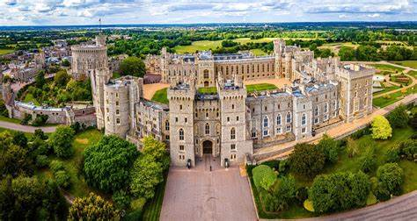
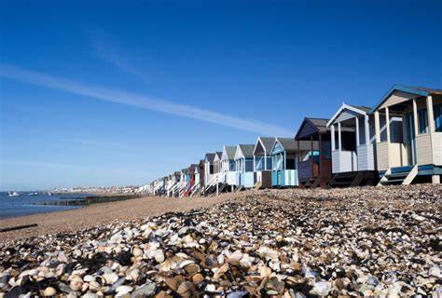
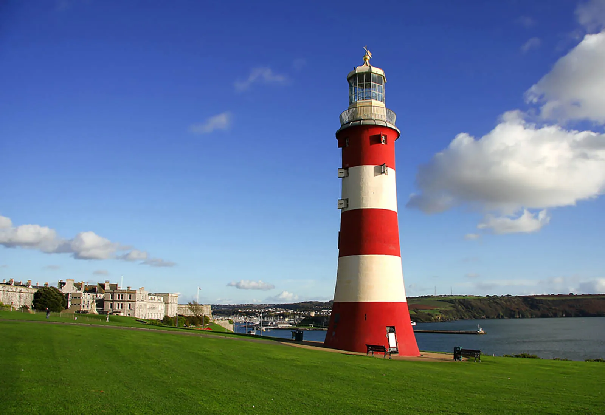
Other Fields of Study will be…
Long live the King!
Crabs, coasts and cornettos.

Slide 7
Daily Routines and Expectations
PE days – The children MUST have their PE kit in school on the first day back.
Homework – Homework will be on Google Classroom, children need to submit their work by the agreed deadline.
Daily Learning kit – We will provide them a pack/pencil case – it is to be looked after!
Daily Reading at home – Reading Records continue – please read with your child. They must be brought in every day.
Contact us at office@thomashickman.bucks.sch.uk

Slide 8
B.I.R.D.S.
Behaviour system – Still in place. You know it well ☺
However, we are always looking to make THS even better and there will be some subtle changes to this next year. You and your children may not notice them day-to-day, but they will focus on developing further our holistic approach to supporting children and families in a bid to make THS and even happier and healthier place to be so that we can maximise learning and success.
Notes:
8

Slide 9
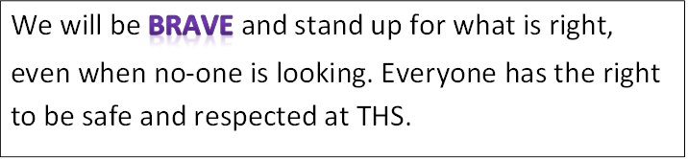
BRAVE

Slide 10
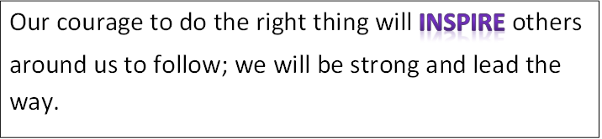
INSPIRE

Slide 11
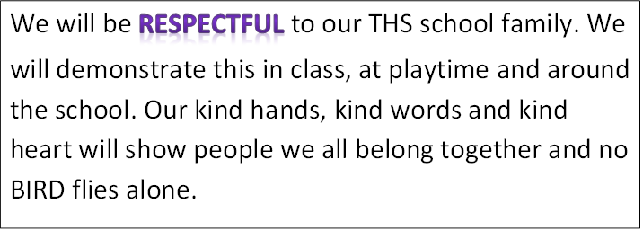
RESPECTFUL

Slide 12
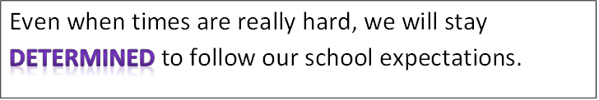
DETERMINED

Slide 13
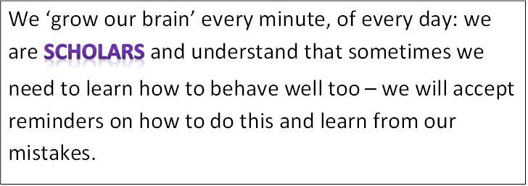
SCHOLARS

Slide 14
B.I.R.D.S
We are all…
Sometimes we may need to restore our behaviour and reflect on some of the choices we made.
Off task behaviour Inappropriate talking/disrupting others who are trying to learn
Attention seeking behaviour such as swinging on chair, calling out, impolite words or actions.
Repetitive noise making, tapping etc.
Preventing others from concentrating

Slide 15
R1
Change behaviour choices now.
Do you need support to restore your behaviour in line with expectations?

Slide 16
R2
BIRDS can’t learn – Time out.
Work at reflection station. Complete work at playtime.

Slide 17
R3
BIRDS can’t learn/aren’t safe – Move out.
Move to another classroom with a 15 minute timer. A phone call will be made home to parent/carers to explain that learning is being affected.
Complete work at playtime and part of lunchtime Only re-enter the classroom after completing restoring your behaviour.
Preventing the teacher from teaching
Preventing BIRDS from ‘growing their brains’.

Slide 18
R4
Urgent changes need to be made.
Working with Assistant Headteacher. Parents/carers will be called into school to meet with AHT and child.
Playtime and lunchtime is isolated with AHT.
Unkind words in or outside class. Unkind action in or out of class. Behaviour not in-line with BIRDS philosophy.

Slide 19
R5
Reported behaviour
Sent to Deputy/Headteacher.
Reported via internal or external exclusion.
Deliberately working against school expectations:
fighting
bullying
swearing
damaging school property
A maximum of 3 internal exclusions in a term can be made before external exclusion is required.

Slide 20
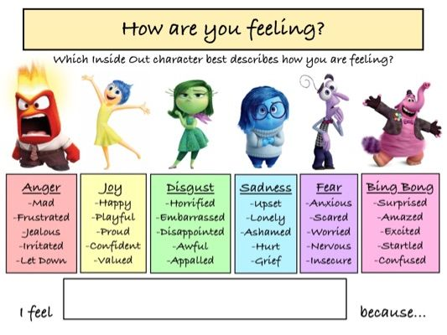
The way we feel can have a huge impact on our day.
Our body will react in different ways depending on how we feel.

Slide 21
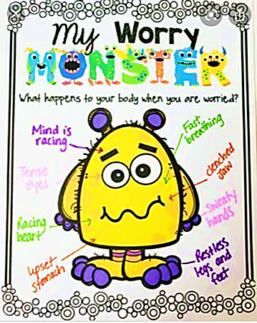
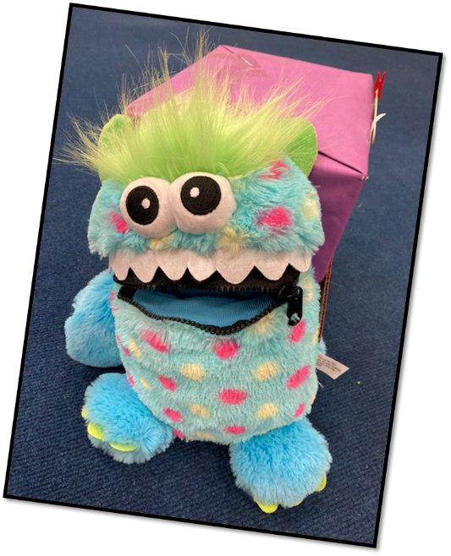
Our Worry Monsters are still here to help you too… when you are worried about something your body reacts in ways that can leave you feeling terrible…
TELL Worry Monster they will help!

Slide 22
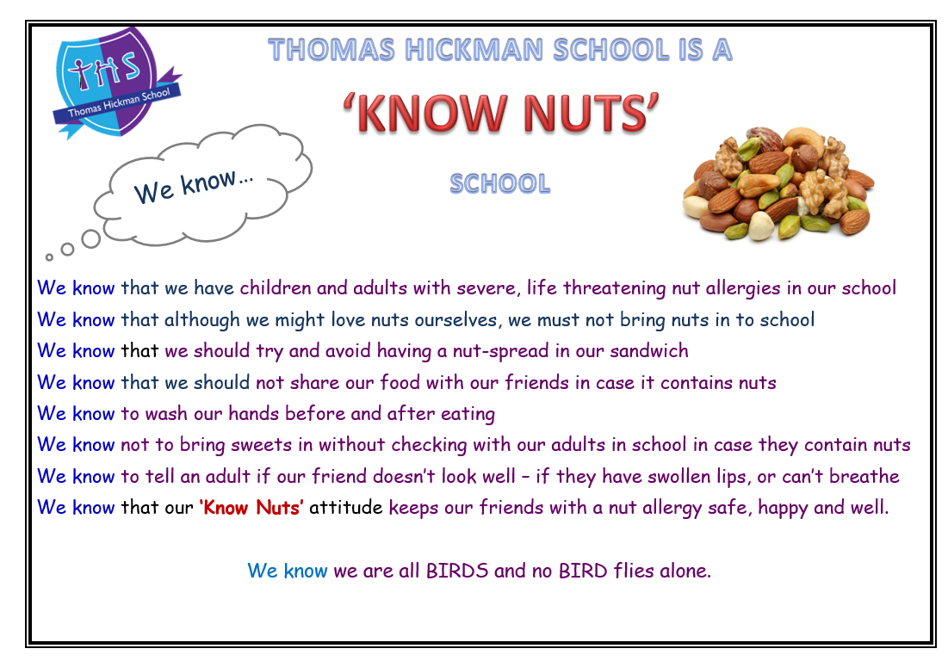

Slide 23
I look forward to seeing you in September and continuing our journey to success!

