Slide 1

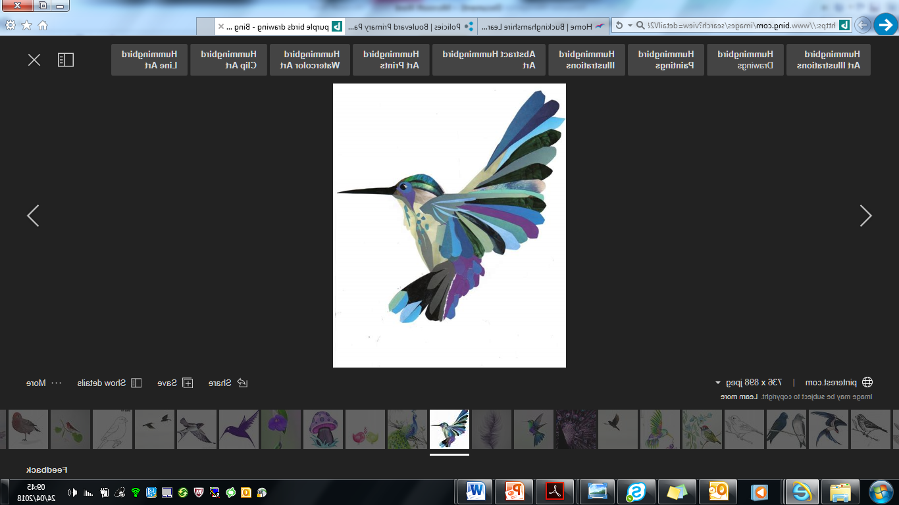

MEET THE TEACHER YEAR 4
4 Elder- Simone Schwartzel
Notes:
I am happy for you to add any pictures etc. which relate to your Move-up Day’s field of study.
1

Slide 2

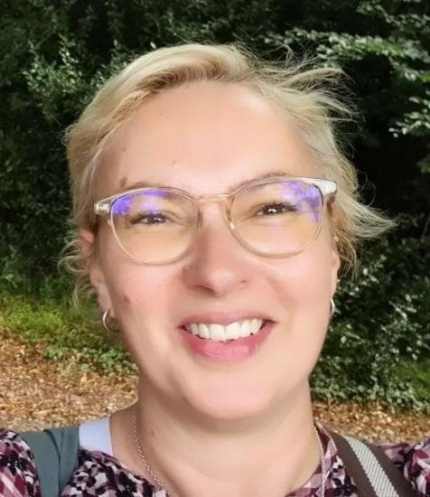
Welcome to Year 4 Elder!
Hello, my name is Simone Schwartzel and I am the class teacher for 4 Elder!

Slide 3
Who am I? Where did I come from? What am I doing here?
I am originally from South Africa but came to the UK in 2010.
I came to teaching a few years after I had already left university where I studied English and Psychology - before I was a teacher I spent a lot time working in book shops. Ordering the children’s books was my specialty.
I am an experienced teacher and have been teaching for over 10 years. I have worked both in South Africa and in England across the primary age range from Year 1 to Year 7.
I am married and have a beautiful cat called Amber.

Slide 4
Why your children are important to me.
Because their innate curiosity that drives them to explore the world around them, inspires me.
I will provide them with a creative and expressive outlet where they will be able to learn at their own pace.
I use lots of praise including Star of the Week certificates, Dojo points and Positive Postcards home, high 5s and big smiles.
We champion BIRDS philosophy and values in and out of school.
Children’s personal interests are encouraged and catered for.
Structured routines with a visual timetables so everyone knows what we are doing and what they need to be successful.
Nurturing and developing a caring and understanding parent/carer – teacher- child relationship, is a MUST for your child to succeed!

Slide 5
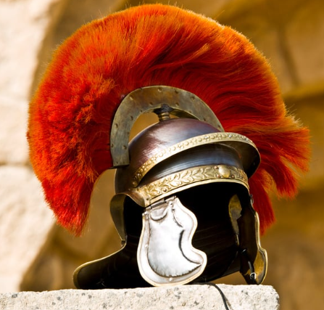
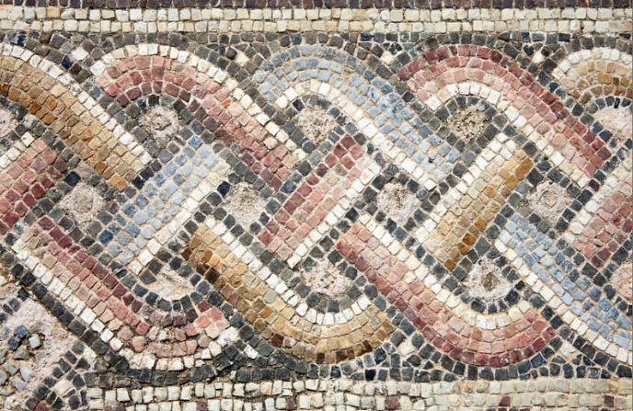
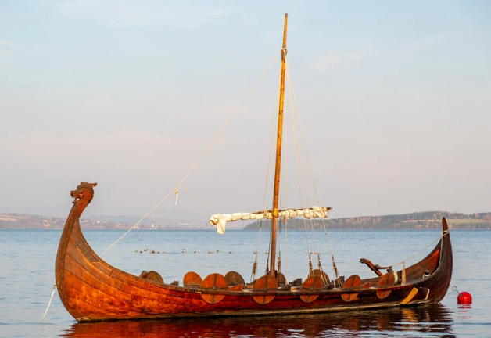
Our first Field of Study unit will be:
Swords and Settlers
As Historians we will:
Learn about The Romans, Anglo-Saxons and Vikings. We will focus our learning on invasions, artefacts, food, homes and settlements, clothing, tools and weapon
As Geographers we will:
Use an atlas to locate countries. Look at physical features of Britain including mountains, marshland and cliffs to explore why it was difficult to invade and travel in Britain.

Slide 6

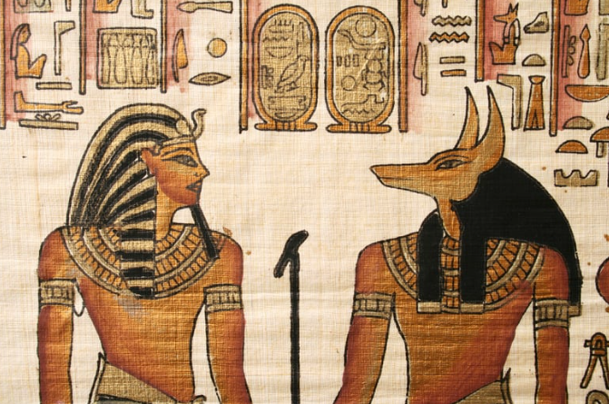

Other Field of Study will include:
You’d find in in a Museum!
River Deep, Mountain High

Slide 7

B.I.R.D.S.
Behaviour system
Notes:
Please take parents through the BIRDS behaviour system
7

Slide 8
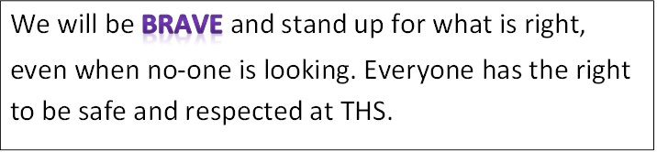

Slide 9
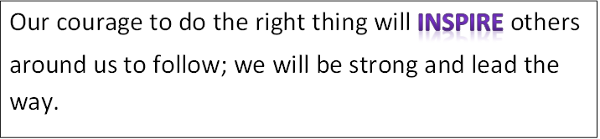

Slide 10
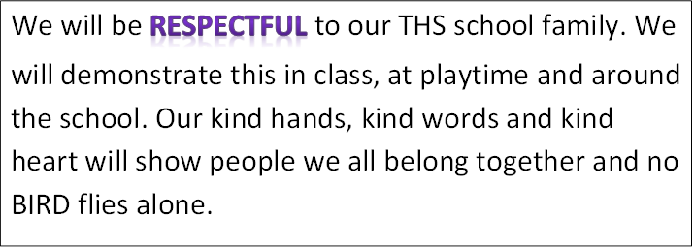

Slide 11
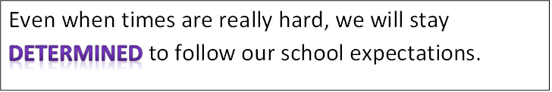

Slide 12
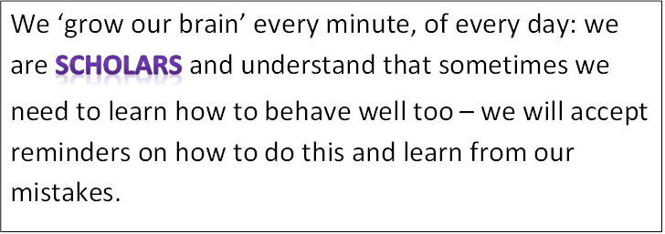

Slide 13
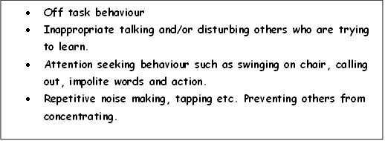
We are all…
B.I.R.D.S
R1 Change behaviour choices now.
Do you need support to restore your behaviour in line with expectations?

Slide 14
We are all…
B.I.R.D.S
R2 BIRDS can’t learn – Time out.
Work at reflection station. Complete work at playtime.

Slide 15
We are all…
B.I.R.D.S
Preventing the teacher from teaching
Preventing BIRDS from ‘growing their brains’.
R3 BIRDS can’t learn/aren’t safe – Move out.
Move to another classroom with a 15 minute timer. A phone call will be made home to parent/carers to explain that learning is being affected.
Complete work at playtime and part of lunchtime Only re-enter the classroom after completing restoring your behaviour.

Slide 16
We are all…
B.I.R.D.S
Unkind words in or outside class. Unkind action in or out of class. Behaviour not in-line with BIRDS philosophy.
R4 Urgent changes need to be made.
Working with Assistant Headteacher. Parents/carers will be called into school to meet with AHT and child.
Playtime and lunchtime is isolated with AHT.

Slide 17
We are all…
B.I.R.D.S
Deliberately working against school expectations:
fighting
bullying
swearing
damaging school property
3
internals only in one term.
Then external
R5 Reported behaviour
Sent to Deputy/Headteacher.
Reported via internal or external exclusion.

Slide 18
How you can help
Each week homework will be set on Reading Eggs, MyMaths and Google classroom.
The work will be set on Friday and is due to be turned in by the following Friday.
The tasks are designed to reinforce your child’s learning in school.

Slide 19
Daily Routines and Expectations
PE kit – Black shorts or joggers, T-shirt in the colour of their house, trainers, socks. I will let you know the PE days as soon as I can.
Homework – to be set on Friday each week on Google Classroom and turned in by the following Friday.
Daily Learning kit – A pack with essential equipment provided by us which your child is then responsible for.
Daily Reading at home for 30 minutes – home/school reading diary and Reading Eggs.

Slide 20
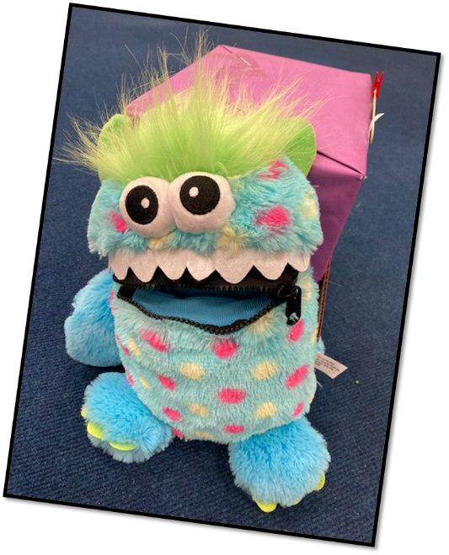

Our Worry Monsters are still here to help you too… when you are worried about something your body reacts in ways that can leave you feeling terrible…
TELL Worry Monster they will help!

Slide 21

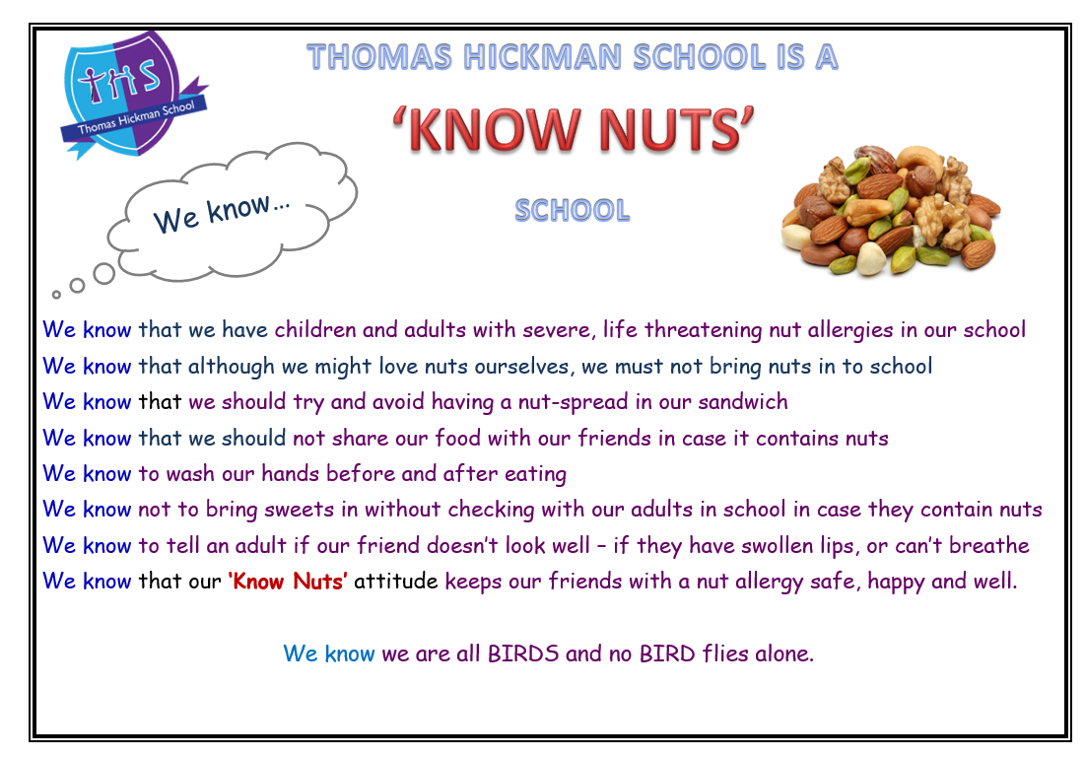

Slide 22
Thank you for coming!
I will be available with an ‘open door’ policy to address any concerns immediately.
Or if there are any issues at all, please email the school and we will contact you as soon as possible.
office@thomashickman.bucks.sch.uk

Slide 23
See you in September to continue our journey to success

