Slide 1

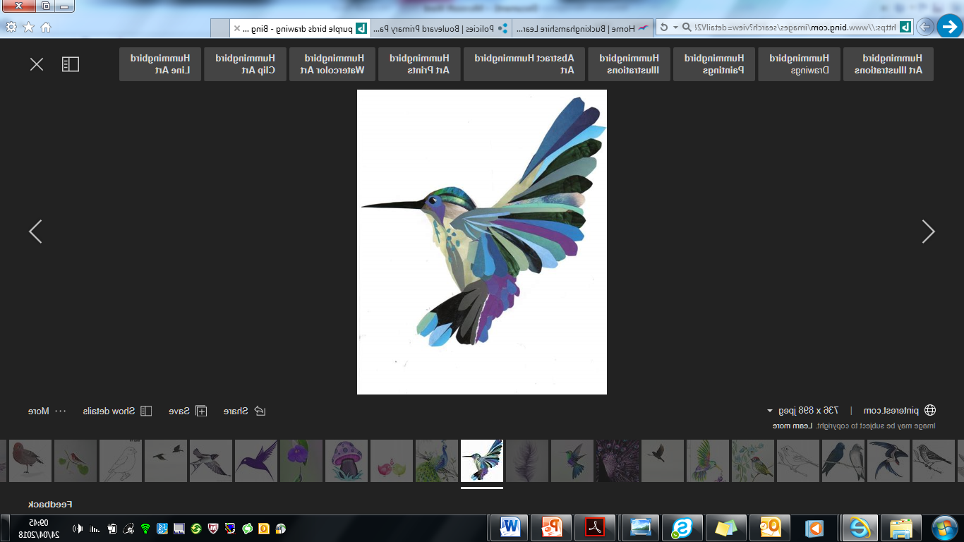

MEET THE TEACHER YEAR 4
Notes:
I am happy for you to add any pictures etc. which relate to your Move-up Day’s field of study.
1

Slide 2
Welcome to Year 4!
Hello, my name is Lauryn Laugie and I am one of the class teachers for Year 4!
I taught in Year 4 last year and I am very familiar with the topics we will be covering. I know I will thoroughly enjoy every minute of delivering our amazing curriculum to this wonderful class coming up!
I feel privileged to have another year in Year 4 especially with all of you!

Slide 3
Who am I? Where did I come from? What am I doing here?
I was born in Aylesbury and I went to Thomas Hickman School!
I am a trained pianist and studied music at university
I have always wanted to be a primary school teacher and have pursued this ambition.
I am an experienced teacher and I have had the opportunity to take care of many of my own year 4 classes in the past.
I have a pet cat and her name is Ulysses!

Slide 4
Welcome to Year 4!
Hi, I’m Dominique Barlow and I am the other Year 4 teacher.
Year 4 is the only year group that I haven’t taught in before but I am excited to get stuck into all of the fun topics we have coming up this year.
I really enjoy teaching in Key Stage 2, so I can’t wait for September to get stuck in!

Slide 5
Who am I? Where did I come from? What am I doing here?
I was born and raised in London but moved to Aylesbury 6 years ago.
I have worked in lots of schools in London, Buckinghamshire, Hertfordshire and Bedfordshire
I have lots of experience working with children so becoming a teacher just made sense. I love watching a child finally understand something they had been working on.
My hidden talent is memorising the names of a class in five minutes.

Slide 6
Why your children are important to us.
Because they are so very important to you!
I will provide them with a calm and positive learning environment.
I use lots of praise including Star of the Week certificates, postcards home, accolades for getting high spelling and times table scores!
BIRDS philosophy and values.
Children’s personal interests.
Structured routines with a visual timetable.
Parent / carer partnership with school.

Slide 7
B.I.R.D.S.
Behaviour system
Notes:
Please take parents through the BIRDS behaviour system
7

Slide 8
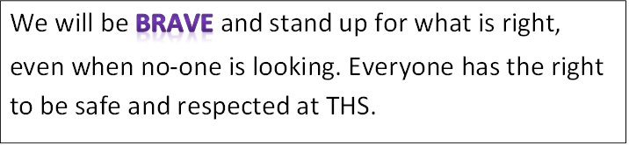

Slide 9
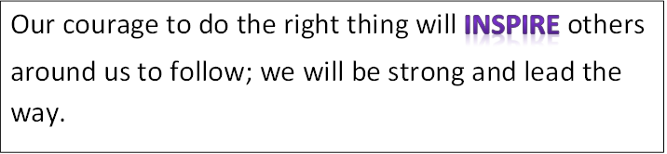

Slide 10
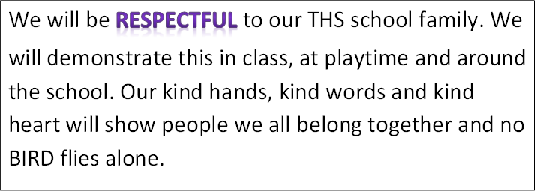

Slide 11
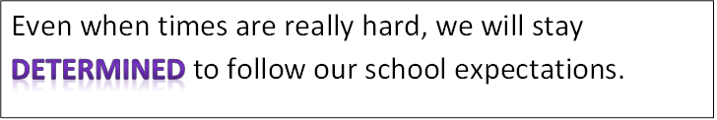

Slide 12
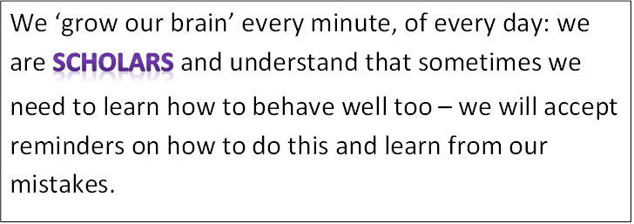

Slide 13
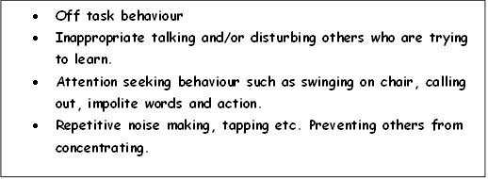
We are all…
B.I.R.D.S
R1 Change behaviour choices now.
Do you need support to restore your behaviour in line with expectations?

Slide 14
We are all…
B.I.R.D.S
R2 BIRDS can’t learn – Time out.
Work at reflection station. Complete work at playtime.

Slide 15
We are all…
B.I.R.D.S
Preventing the teacher from teaching
Preventing BIRDS from ‘growing their brains’.
R3 BIRDS can’t learn/aren’t safe – Move out.
Move to another classroom with a 15 minute timer. A phone call will be made home to parent/carers to explain that learning is being affected.
Complete work at playtime and part of lunchtime Only re-enter the classroom after completing restoring your behaviour.

Slide 16
We are all…
B.I.R.D.S
Unkind words in or outside class. Unkind action in or out of class. Behaviour not in-line with BIRDS philosophy.
R4 Urgent changes need to be made.
Working with Assistant Headteacher. Parents/carers will be called into school to meet with AHT and child.
Playtime and lunchtime is isolated with AHT.

Slide 17
We are all…
B.I.R.D.S
Deliberately working against school expectations:
fighting
bullying
swearing
damaging school property
3
internals only in one term.
Then external
R5 Reported behaviour
Sent to Deputy/Headteacher.
Reported via internal or external exclusion.

Slide 18
Our new field of study is …..
Swords and Settlers! This one is fabulous!
Our learning will include:
The invasion of Britain during the period AD410.
We will focus our learning on the significant events of the early middle ages, Anglo-Saxon invasion, everyday life, the first invasion, the first viking landing.
Study the location of the countries and how the geographical features affected how and where they invaded.
Building our skills and knowledge on map reading.
We are hoping to arrange an immersive experience with a historical workshop to support the children’s learning.

Slide 19
How you can help
Each week homework will be set on My Maths.
The work will be set on Friday and is due to be turned in by the following Friday.
There will be a Maths activity and a Phonics / English activity set each week.
The tasks are designed to reinforce your child’s learning in school.
Tasks should be turned in on Google Classroom.
Children can use their homework jotters at home but these do not need to be handed in.

Slide 20
Daily Routines and Expectations
PE kit – Black shorts or joggers, T-shirt in the colour of their house, trainers, socks. I will let you know the PE days as soon as I can.
Homework – to be set on Friday each week on My Maths and turned in by the following Friday.
Daily Learning kit – A pack with essential equipment provided by us which your child is then responsible for.
Daily Reading at home – home/school reading diary.

Slide 21
Thank you for coming!
I will be available with an ‘open door’ policy to address any concerns immediately.
Or if there are any issues at all, please email the school and we will contact you as soon as possible.
dl@thomashickman.bucks.sch.uk

Slide 22
See you in September to continue our journey to success …

